Slide 1
Anchoring Vignettes, Ranking Methods, and Situational Judgment Testing for Improving the Quality of Self-Reports
Patrick Kyllonen
Educational Testing Service
Princeton, NJ
Conference on Measuring and Assessing Skills
Session 1: Using Tests, Observer Reports, and Self Reports for Measuring Skills
Center for the Economics of Human Development
The University of Chicago
October 1, 2015

Slide 2
Outline
Problems with ratings
Anchoring vignettes
Ranking/Forced-choice methods
Situational Judgment testing

Slide 3
Problems with Ratings

Slide 4
Problems with rating scales
  Motivated responding (e.g., wanting to look good, or bad)
  Reference group bias (to whom you compare yourself)
  Response style bias (e.g., extreme responses, modesty)
  Lack of differentiation in others’ ratings (halo, horn)
  Cross-cultural comparability (to compare countries x and y) (next page)

Slide 5
Cross-Cultural Comparability
Attitude-achievement “paradox”
  Positive average within country correlations
    “Better attitudes are associated with higher achievement”
  Negative country-level correlations
    “Countries with high average attitude scores are ones with lower average achievement”
    “Countries with low average attitudes are ones with high achievement”

Slide 6
3 correlations: Within-country positive, pooled zero, Between-country negative
Within-country
Pooled sample
(3 countries)
Country means (63 countries)
Based on PISA 2012 Field Trial data

Slide 7
There are methods to address these problems
Situational judgment tests
Forced-choice assessments
Anchoring vignettes
Performance measures (other sessions in this conference)
Ratings by others (teachers, parents)

Slide 8
Anchoring Vignettes

Slide 9
What are Anchoring Vignettes?
Method for rescaling Likert scale responses to respondent’s personal anchors
  Developed by Wand & King http://gking.harvard.edu/vign/ (King et al., 2004; King & Wand, 2007)
Growing in popularity
  Used in surveys (e.g., sociology, political science, NIA)
  PISA 2012 Field Trial first time in educational surveys

Slide 10
 | ST61
02 | Thinking about the mathematics teacher who taught your last mathematics class. To what extent do you agree with the following statements?
 | (Please check only one box on each row.)
 |  | Strongly agree | Agree | Disagree | Strongly disagree
a) | My teacher lets students know they need to work hard. | 1 | 2 | 3 | 4
b) | My teacher provides extra help when needed. | 1 | 2 | 3 | 4
c) | My teacher helps students with their learning. | 1 | 2 | 3 | 4
d) | My teacher gives students the opportunity to express opinions. | 1 | 2 | 3 | 4
Teacher Support Scale

Slide 11
 | ST61
02 | Thinking about the mathematics teacher who taught your last mathematics class. To what extent do you agree with the following statements?
 | (Please check only one box on each row.)
 |  | Strongly agree | Agree | Disagree | Strongly disagree
a) | My teacher lets students know they need to work hard. | 1 | 2 | 3 | 4
Teacher Support Scale

Slide 12
 | ST61
01 | Below you will find descriptions of three mathematics teachers. Read each of the descriptions of these teachers. Then let us know to what extent you agree with the final statement.
 | (Please check only one box on each row.)
 |  | Strongly agree | Agree | Disagree | Strongly disagree
a) | Ms. Anderson assigns mathematics homework every other day. She always gets the answers back to students before examinations. Ms. Anderson is concerned about her students’ learning. | 1 | 2 | 3 | 4
b) | Mr. Crawford assigns mathematics homework once a week. He always gets the answers back to students before examinations. Mr. Crawford is concerned about his students’ learning. | 1 | 2 | 3 | 4
c) | Ms. Dalton assigns mathematics homework once a week. She never gets the answers back to students before examinations. Ms. Dalton is concerned about her students’ learning. | 1 | 2 | 3 | 4
Teacher Support Questions

Slide 13
 | ST61
01 | Below you will find descriptions of three mathematics teachers. Read each of the descriptions of these teachers. Then let us know to what extent you agree with the final statement.
 | (Please check only one box on each row.)
 |  | Strongly agree | Agree | Disagree | Strongly disagree
a) | Ms. Anderson assigns mathematics homework every other day. She always gets the answers back to students before examinations. Ms. Anderson is concerned about her students’ learning. | 1 | 2 | 3 | 4
b) | Mr. Crawford assigns mathematics homework once a week. He always gets the answers back to students before examinations. Mr. Crawford is concerned about his students’ learning. | 1 | 2 | 3 | 4
c) | Ms. Dalton assigns mathematics homework once a week. She never gets the answers back to students before examinations. Ms. Dalton is concerned about her students’ learning. | 1 | 2 | 3 | 4
Student “A’s” responses

Slide 14
 | ST61
01 | Below you will find descriptions of three mathematics teachers. Read each of the descriptions of these teachers. Then let us know to what extent you agree with the final statement.
 | (Please check only one box on each row.)
 |  | Strongly agree | Agree | Disagree | Strongly disagree
a) | Ms. Anderson assigns mathematics homework every other day. She always gets the answers back to students before examinations. Ms. Anderson is concerned about her students’ learning. | 1 | 2 | 3 | 4
b) | Mr. Crawford assigns mathematics homework once a week. He always gets the answers back to students before examinations. Mr. Crawford is concerned about his students’ learning. | 1 | 2 | 3 | 4
c) | Ms. Dalton assigns mathematics homework once a week. She never gets the answers back to students before examinations. Ms. Dalton is concerned about her students’ learning. | 1 | 2 | 3 | 4
Student “B’s” responses

Slide 15
 | ST61
01 | Below you will find descriptions of three mathematics teachers. Read each of the descriptions of these teachers. Then let us know to what extent you agree with the final statement.
 | (Please check only one box on each row.)
 |  | Strongly agree | Agree | Disagree | Strongly disagree
a) | Ms. Anderson assigns mathematics homework every other day. She always gets the answers back to students before examinations. Ms. Anderson is concerned about her students’ learning. | 1 | 2 | 3 | 4
b) | Mr. Crawford assigns mathematics homework once a week. He always gets the answers back to students before examinations. Mr. Crawford is concerned about his students’ learning. | 1 | 2 | 3 | 4
c) | Ms. Dalton assigns mathematics homework once a week. She never gets the answers back to students before examinations. Ms. Dalton is concerned about her students’ learning. | 1 | 2 | 3 | 4
02 | My teacher lets students know they need to work hard. | 1 | 2 | 3 | 4
Student “A’s” responses
For Student “A” this can be interpreted as “like the middle hypothetical teacher”

Slide 16
 | ST61
01 | Below you will find descriptions of three mathematics teachers. Read each of the descriptions of these teachers. Then let us know to what extent you agree with the final statement.
 | (Please check only one box on each row.)
 |  | Strongly agree | Agree | Disagree | Strongly disagree
a) | Ms. Anderson assigns mathematics homework every other day. She always gets the answers back to students before examinations. Ms. Anderson is concerned about her students’ learning. | 1 | 2 | 3 | 4
b) | Mr. Crawford assigns mathematics homework once a week. He always gets the answers back to students before examinations. Mr. Crawford is concerned about his students’ learning. | 1 | 2 | 3 | 4
c) | Ms. Dalton assigns mathematics homework once a week. She never gets the answers back to students before examinations. Ms. Dalton is concerned about her students’ learning. | 1 | 2 | 3 | 4
02 | My teacher lets students know they need to work hard. | 1 | 2 | 3 | 4
Student “B’s” responses
For Student “B” this can be interpreted as “better than the best hypothetical teacher”

Slide 17
 | ST61
01 | Below you will find descriptions of three mathematics teachers. Read each of the descriptions of these teachers. Then let us know to what extent you agree with the final statement.
 | (Please check only one box on each row.)
 |  | Strongly agree | Agree | Disagree | Strongly disagree
a) | Ms. Anderson assigns mathematics homework every other day. She always gets the answers back to students before examinations. Ms. Anderson is concerned about her students’ learning. | 1 | 2 | 3 | 4
b) | Mr. Crawford assigns mathematics homework once a week. He always gets the answers back to students before examinations. Mr. Crawford is concerned about his students’ learning. | 1 | 2 | 3 | 4
c) | Ms. Dalton assigns mathematics homework once a week. She never gets the answers back to students before examinations. Ms. Dalton is concerned about her students’ learning. | 1 | 2 | 3 | 4
02 | My teacher lets students know they need to work hard. | 1 | 2 | 3 | 4
Student “A’s” responses
For Student “A” this can be interpreted as “at the same level as the middle hypothetical teacher”

Slide 18
 | ST61
01 | Below you will find descriptions of three mathematics teachers. Read each of the descriptions of these teachers. Then let us know to what extent you agree with the final statement.
 | (Please check only one box on each row.)
 |  | Strongly agree | Agree | Disagree | Strongly disagree
a) | Ms. Anderson assigns mathematics homework every other day. She always gets the answers back to students before examinations. Ms. Anderson is concerned about her students’ learning. | 1 | 2 | 3 | 4
b) | Mr. Crawford assigns mathematics homework once a week. He always gets the answers back to students before examinations. Mr. Crawford is concerned about his students’ learning. | 1 | 2 | 3 | 4
c) | Ms. Dalton assigns mathematics homework once a week. She never gets the answers back to students before examinations. Ms. Dalton is concerned about her students’ learning. | 1 | 2 | 3 | 4
02 | My teacher lets students know they need to work hard. | 1 | 2 | 3 | 4
Student “A’s” responses
For Student “A” this can be interpreted as “at the same level as the best hypothetical teacher”

Slide 19
 | ST61
01 | Below you will find descriptions of three mathematics teachers. Read each of the descriptions of these teachers. Then let us know to what extent you agree with the final statement.
 | (Please check only one box on each row.)
 |  | Strongly agree | Agree | Disagree | Strongly disagree
a) | Ms. Anderson assigns mathematics homework every other day. She always gets the answers back to students before examinations. Ms. Anderson is concerned about her students’ learning. | 1 | 2 | 3 | 4
b) | Mr. Crawford assigns mathematics homework once a week. He always gets the answers back to students before examinations. Mr. Crawford is concerned about his students’ learning. | 1 | 2 | 3 | 4
c) | Ms. Dalton assigns mathematics homework once a week. She never gets the answers back to students before examinations. Ms. Dalton is concerned about her students’ learning. | 1 | 2 | 3 | 4
02 | My teacher lets students know they need to work hard. | 1 | 2 | 3 | 4
Student “A’s” responses
For Student “A” this can be interpreted as “at the same level as the worst hypothetical teacher”

Slide 20
 | ST61
01 | Below you will find descriptions of three mathematics teachers. Read each of the descriptions of these teachers. Then let us know to what extent you agree with the final statement.
 | (Please check only one box on each row.)
 |  | Strongly agree | Agree | Disagree | Strongly disagree
a) | Ms. Anderson assigns mathematics homework every other day. She always gets the answers back to students before examinations. Ms. Anderson is concerned about her students’ learning. | 1 | 2 | 3 | 4
b) | Mr. Crawford assigns mathematics homework once a week. He always gets the answers back to students before examinations. Mr. Crawford is concerned about his students’ learning. | 1 | 2 | 3 | 4
c) | Ms. Dalton assigns mathematics homework once a week. She never gets the answers back to students before examinations. Ms. Dalton is concerned about her students’ learning. | 1 | 2 | 3 | 4
02 | My teacher lets students know they need to work hard. | 1 | 2 | 3 | 4
Student “A’s” responses
For Student “A” this can be interpreted as “between the middle and the worst hypothetical teacher”

Slide 21
 | ST61
01 | Below you will find descriptions of three mathematics teachers. Read each of the descriptions of these teachers. Then let us know to what extent you agree with the final statement.
 | (Please check only one box on each row.)
 |  | Strongly agree | Agree | Disagree | Strongly disagree
a) | Ms. Anderson assigns mathematics homework every other day. She always gets the answers back to students before examinations. Ms. Anderson is concerned about her students’ learning. | 1 | 2 | 3 | 4
b) | Mr. Crawford assigns mathematics homework once a week. He always gets the answers back to students before examinations. Mr. Crawford is concerned about his students’ learning. | 1 | 2 | 3 | 4
c) | Ms. Dalton assigns mathematics homework once a week. She never gets the answers back to students before examinations. Ms. Dalton is concerned about her students’ learning. | 1 | 2 | 3 | 4
02 | My teacher lets students know they need to work hard. | 1 | 2 | 3 | 4
Student “C’s” responses
For Student “C” this can be interpreted as “lower than the worst hypothetical teacher(s)”

Slide 22
 | ST61
01 | Below you will find descriptions of three mathematics teachers. Read each of the descriptions of these teachers. Then let us know to what extent you agree with the final statement.
 | (Please check only one box on each row.)
 |  | Strongly agree | Agree | Disagree | Strongly disagree
a) | Ms. Anderson assigns mathematics homework every other day. She always gets the answers back to students before examinations. Ms. Anderson is concerned about her students’ learning. | 1 | 2 | 3 | 4
b) | Mr. Crawford assigns mathematics homework once a week. He always gets the answers back to students before examinations. Mr. Crawford is concerned about his students’ learning. | 1 | 2 | 3 | 4
c) | Ms. Dalton assigns mathematics homework once a week. She never gets the answers back to students before examinations. Ms. Dalton is concerned about her students’ learning. | 1 | 2 | 3 | 4
02 | My teacher lets students know they need to work hard. | 1 | 2 | 3 | 4
Student “C’s” responses
For Student “C” this can be interpreted as “lower than the worst hypothetical teacher(s)” (same as previous)

Slide 23
 | ST61
01 | Below you will find descriptions of three mathematics teachers. Read each of the descriptions of these teachers. Then let us know to what extent you agree with the final statement.
 | (Please check only one box on each row.)
 |  | Strongly agree | Agree | Disagree | Strongly disagree
a) | Ms. Anderson assigns mathematics homework every other day. She always gets the answers back to students before examinations. Ms. Anderson is concerned about her students’ learning. | 1 | 2 | 3 | 4
b) | Mr. Crawford assigns mathematics homework once a week. He always gets the answers back to students before examinations. Mr. Crawford is concerned about his students’ learning. | 1 | 2 | 3 | 4
c) | Ms. Dalton assigns mathematics homework once a week. She never gets the answers back to students before examinations. Ms. Dalton is concerned about her students’ learning. | 1 | 2 | 3 | 4
02 | My teacher lets students know they need to work hard. | 1 | 2 | 3 | 4
Student “C’s” responses
For Student “C” this can be interpreted as “lower than the worst hypothetical teacher(s)” (same as previous)

Slide 24
Consistent Relationships within and across countries
Within-country
Pooled sample
(3 countries)
Country means (63 countries)
Likert scale score
Based on PISA 2012 Field Trial data

Slide 25
Consistent Relationships within and across countries
Within-country
Pooled sample
(3 countries)
Country means (63 countries)
Likert scale score
Anchoring vignette score

Slide 26
Correlations: Attitudes & Math proficiency
 |  | Ave within country r | Country level r
 |  | N = 5000 * 63 | N = 63
Teacher support | Likert | .04 | -.41
 | Anchored | .13 | .22
Classroom management | Likert | .07 | -.38
 | Anchored | .20 | .56

Slide 27
 | ST61
01 | Below you will find descriptions of three mathematics teachers. Read each of the descriptions of these teachers. Then let us know to what extent you agree with the final statement.
 | (Please check only one box on each row.)
 |  | Strongly agree | Agree | Disagree | Strongly disagree
a) | Ms. Anderson assigns mathematics homework every other day. She always gets the answers back to students before examinations. Ms. Anderson is concerned about her students’ learning. | 1 | 2 | 3 | 4
b) | Mr. Crawford assigns mathematics homework once a week. He always gets the answers back to students before examinations. Mr. Crawford is concerned about his students’ learning. | 1 | 2 | 3 | 4
c) | Ms. Dalton assigns mathematics homework once a week. She never gets the answers back to students before examinations. Ms. Dalton is concerned about her students’ learning. | 1 | 2 | 3 | 4
02 | I enjoy reading about mathematics | 1 | 2 | 3 | 4
Mathematics interest item

Slide 28
Anchors for one scale can be used to recode a second, unrelated scale (not recommended, but illustrative)
 |  | Ave within country r | Country level r
 |  | N = 200 – 1000 | N = 63
Teacher support | Likert | .03 | -.45
 | Anchored | .13 | .29
Student- Teacher Relations | Likert | .05 | -.41
 | Anchored* | 14 | .40
Mathematics Interest | Likert | .17 | -.50
 | Anchored* | .22 | .14
* Anchored to the Teacher Support vignettes

Slide 29
Country level anchoring does not work as well as individual level anchoring
 |  | Ave within country r | Country level r
 |  | N = 200 – 1000 | N = 63
Teacher support | Likert | .03 | -.45
 | Anchored | .13 | .29
 | Country -anchored | .02 | .06

Slide 30
Big 5 Anchoring Vignettes
Mary is often late for work. She rarely completes her work assignments on time. She does little planning. | Cindy returns phone calls in a timely fashion. She sometimes forgets to bring materials she needs for work. She avoids mistakes. | Judy frequently makes lists. She often works longer than her colleagues. She is always well prepared.
strongly disagree disagree agree strongly agree
Mary is a conscientious person    
Cindy is a conscientious person    
Judy is a conscientious person    
strongly disagree disagree agree strongly agree
I work hard    
I keep lists    
I plan ahead    
I complete my assignments on time    

Slide 31
Parametric Approach
Compound Hierarchical Ordered Probit (CHOPIT) model (King et al., 2004)
  See Hana Vonkova, Zamarro, & Degerg, 2015, PISA analysis
    H.voncova@gmail.com
Students report on their teachers within a set of threshholds, with students varying on where they set their threshholds; One country serves as the reference country, ML estimation
Advantages to parametric approach
  Handles ties and violations, assumes them to be error
  Parameters (threshholds) can be related to student information (e.g., countries)
  Reference group + deviations, expressed on original (4-pt) scale
  Less data hungry
  http://cran.r-project.org/web/packages/anchors/vignettes/anchors.pdf

Slide 32
Findings so far
We have developed anchoring vignettes for many constructs, from Big 5 to emotional intelligence, for students and teachers
Anchoring vignettes work very well on poorly anchored scales (much of personality assessment)
They improve cross-country comparability; they also increase validity within a country (correlations with achievement)
It is important to write vignettes so that students rate them appropriately
Low achievement scores are associated with ties and violations (comprehension or motivation problem)

Slide 33
Promise
Vignettes could be used to scale growth over time
E.g.,
30% 1st graders rate themselves higher than a middle vignette
45% 2nd graders rate themselves higher than the same middle vignette

Slide 34
Forced-choice Methods

Slide 35
Forced-Choice Methods
What are they?
Review of findings
2 scoring models

Slide 36
Why Forced Choice?
Please indicate your answer to each item by clicking on the appropriate circle
 |  | Strongly disagree | Disagree | Agree | Strongly agree
1. | I usually make a noticeable contribution to group problem-solving tasks | ⃝ | ⃝ | ⃝ | ⃝
2. | I am generally pretty forgiving | ⃝ | ⃝ | ⃝ | ⃝
Vs.
For each pair of statements please click on the one that is most like you
1. | I usually make a noticeable contribution to group problem-solving tasks | ⃝
2. | I am generally pretty forgiving | ⃝
Drasgow, F., Stark, S., Chernyshenko, O.S., Nye, C.D., Hulin, C.L., White, L. A. (2012). Development of the Tailored Adaptive Personality Assessment System (TAPAS) to Support Army Selection and Classification Decisions. ARI Technical Report 1311. Fort Belvoir, VA: U.S. Army Research Institute for the Behavioral and Social Sciences

Slide 37
Why Forced-Choice?
High stakes
  Reduces faking (vignettes are easy to fake)
Low and high stakes
  Reduces response style bias (like vignettes)
Others’ ratings
  Reduces “halo” and “horn” effects

Slide 38
Example for Forced Choice in PISA 2012:
Mathematics Intentions
Forced-Choice instrument asks students to indicate their PREFERENCES for math, language and science

Slide 39
Forced Choice: Learning Strategies
Forced-Choice instrument asks students to indicate their PREFERENCES out of three possible behaviors.

Slide 40
Correlations with Mathematics Proficiency – Likert vs. Forced-Choice
 |  | Correlation with Math Proficiency
 |  | Average Within-Country | Between-Country
Forced Choice |  | .09 | .60
Likert |  | .08 | -.46
Forced Choice |  | .21 | .32
Likert |  | .10 | -.31
Learning Strategies
Math Intentions

Slide 41
Pairs
For each pair of statements please click on the one that is most like you
❍ | I have the ability to make others feel interesting.
❍ | I keep my appointments

Slide 42
Triplets
For each pair of statements please click on the one that is most like you and the one least like you
most | least
❍ | ❍ | I like hard jobs better than easy ones.
❍ | ❍ | I learn quickly.
❍ | ❍ | I keep my emotions under control.

Slide 43
Tetrads
For each pair of statements please click on the one that is most like you and the one least like you
most | least
❍ | ❍ | I like music.
❍ | ❍ | I seek to be the best.
❍ | ❍ | I cheer people up.
❍ | ❍ | I can stand a great deal of stress.

Slide 44
Tetrads (Multidimensional)
For each pair of statements please click on the one that is most like you and the one least like you
most | least
❍ | ❍ | I like music. (Openness)
❍ | ❍ | I seek to be the best. (Conscientiousness)
❍ | ❍ | I cheer people up. (Agreeableness)
❍ | ❍ | I can stand a great deal of stress. (Emotional)
Each choice reflects a different dimension

Slide 45
Multidimensional Ranking
Rank the following from which is most like you (1) to which is least like you (4)
1 | 2 | 3 | 4
❍ | ❍ | ❍ | ❍ | I like music. (Openness)
❍ | ❍ | ❍ | ❍ | I seek to be the best. (Conscientiousness)
❍ | ❍ | ❍ | ❍ | I cheer people up. (Agreeableness)
❍ | ❍ | ❍ | ❍ | I can stand a great deal of stress. (Emotional)

Slide 46
Forced-choice and Likert methods can give similar results
(same culture; under low stakes conditions)
Personality Factor | Likert vs. forced choice (same item pool) | Likert only (2 different item pools) | Forced-choice only (2 different item pools)
Emotional Stability | .81 | .68 | .59
Extroversion | .87 | .67 | .58
Openness | .75 | .76 | .65
Agreeableness | .75 | .70 | .64
Conscientiousness | .83 | .81 | .71
Haggestad, E.D. (2006). Faking in personnel selection: Does it matter and can we do anything about it? Educational Testing Service mini-conference on faking. Princeton, NJ: ETS.

Slide 47
Pairs (Multidimensional)
For each pair of statements please click on the one that is most like you
❍ | I have the ability to make others feel interesting (A, E)
❍ | I keep my appointments (C)
Each choice reflects a different dimension

Slide 48
Pairs (Unidimensional)
For each pair of statements please click on the one that is most like you
❍ | I can never find anything. (-C)
❍ | I put things back in their proper place. (C)
Both choices reflect the same dimension (they vary on the level)

Slide 49
Ipsative Data
Definition
  Every time you choose an item (e.g., in a pair), you get 1 point for the construct that item represents. There are a fixed number of points (i.e., the number of pairs) in the block of items. Every person taking the test has the same number of total points.
Example
  Two dimensions (E and O), 10 items
  Your sum of E and O choices must add to 10

Slide 50
Ipsative Data
Average correlation among scales
= -1 /(d – 1) (min)(when scale variances are equal this also max*)
  (d – 4)/d (max) (d: number of dimensions)
e.g., with 2 dimensions, r = -1.00
with 3 dimensions, r = -.50 to -.33
with 20 dimensions, r = -0.05 to .80
Vs. normative data average, r = -1/(d-1) to 1 **
Average validity = 0 (every positive prediction with a criterion is balanced by a negative one) (when scale variances equal)
Standard reliability formulas do not apply (test-retest ok)
Cannot do factor analysis with ipsative scores
*Clemans, W.V. (1966). An analtyical and empirical examination of some properties of ispative measures. Psychometric Monographs, 14, 1-56.
**Gleser, L.J. (1972). On bounds for the average correlation between subtest scores in ipsatively scored tests. Educational and Psychological measurement, 32, 759-765.

Slide 51
Normative Data from Forced-Choice
The Myers-Briggs Type Indicator (the most widely used personality test in the world) uses this method
❍ | I can never find anything. (-C)
❍ | I put things back in their proper place. (C)

Slide 52
Quasi-Ipsative Data
Purely ipsative means that the sum of the scores on all the dimensions is the same for everyone
Quasi-ipsative means that is not altogether true
Here are ways to make a scale quasi-ipsative
  Use many dimensions, but do not score them all (e.g., present forced-choice with 32 dimensions but only score 20; the remaining dimensions are distractor dimensions)
  Dimensions have different numbers of items
  Item-response theory models that provide normative scores from ipsative measurement

Slide 53
Empirical findings on Forced Choice vs. Single Statements
Forced-choice shows higher validities vs. single statements with same statements
  Brown & Bartram (2009); Bartram (2012)
Meta-analysis of r (conscientiousness, academic & job performance)
  Quasi-ipsative = .40
  Ipsative = .16
  Normative (forced choice) = .16
  Normative (single statement) = .28
Brown, A., & Bartram, D. (2009, April). Doing less but getting more: Improving forced-choice measures with IRT. Paper presented at the 24th annual conference of the Society for Industrial and Organizational Psychology, New Orleans, LA.
Salgado, J.F., & Táuriz, G. (2012): The Five-Factor Model, forced-choice personality inventories and performance: A comprehensive meta-analysis of academic and occupational validity studies, European Journal of Work and Organizational Psychology, DOI:10.1080/1359432X.2012.716198

Slide 54
Cross-cultural comparability
Country-level correlations (n = 19) between |  | UN Human Development Index (education, life expectancy, GDP) | Global competitive index (WEF), requirements, efficiency, innovation
Agreeableness | Single Statement | .09 | .39
 | Forced Choice | .57 | .58
Emotional stability | Single Statement | .07 | .50
 | Forced choice | .27 | .53
Extraversion | Single Statement | .41 | .20
 | Forced choice | .76 | .46
Conscientiousness | Single Statement | -.46 | -.40
 | Forced Choice | -.08 | .21
(Bartram, 2013)

Slide 55
IRT Scoring of Forced Choice Measures
A. Brown & Maydeu-Olivares (2011)
  Combined ideas from Thurstone (1927) scaling of preference data (“law of comparative judgment”) with confirmatory factor analysis
  Designed to re-score existing forced choice measures which had been ipsatively scored (SHL’s OPQ32i)
Stark, Drasgow, Chernyshenko’s (2005) ideal-points modeling approach using Jim Roberts’ GGUM
  Assumes not a “dominance” model but an “ideal points” model (calibrations from ratings)
“I enjoy talking to a friend in a quiet cafeteria”
  You can disagree with an item “from above” or “below”
  Second phase fits MUPP model

Slide 56
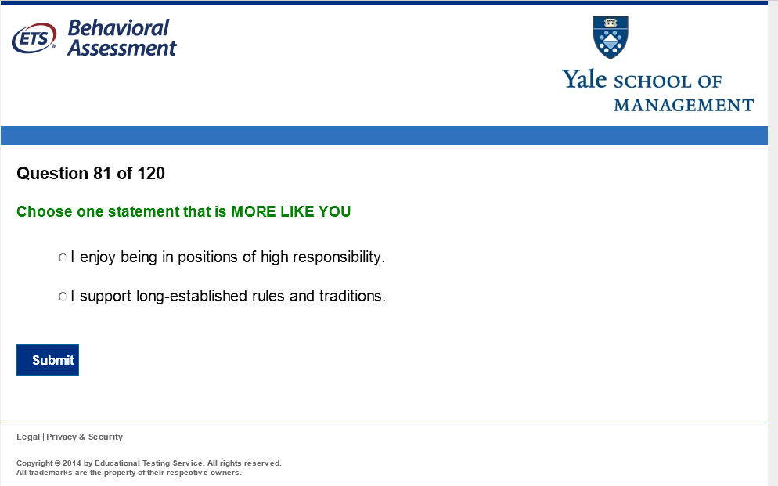
FACETS

Slide 57
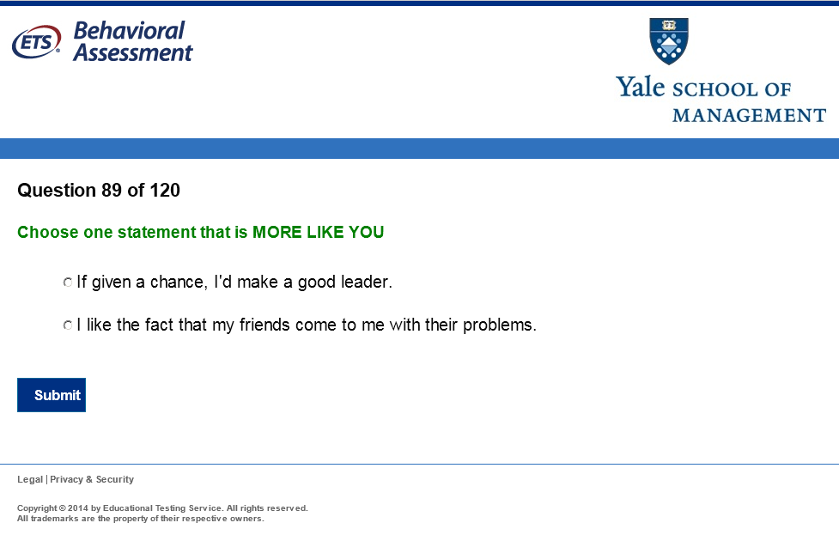
FACETS

Slide 58
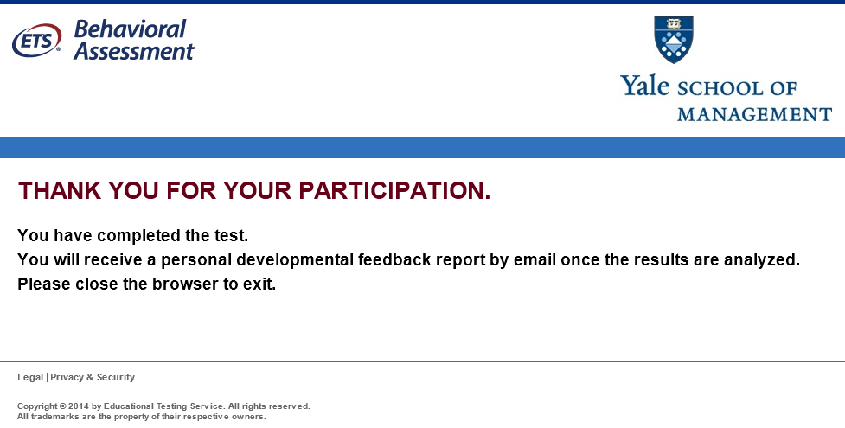
FACETS
assessment.

Slide 59
Details of administration—Business School
300+ students enrolled in the program, given FACETS (They already had GRE/GMAT scores, and Undergraduate GPA, UGPA)
  1/3 foreign national
  2/3 male
  13% underrepresented minority
  Age: 2/3 between 25–30 the remaining 1/3 split between younger and older

Slide 60
Multiple regression models: GGPA
Outcome: Cumulative Graduate GPA
Model #: Predictor(s) | adj R^2 | Model 4 b | Model 4 se (b) | t
1: UGPA | .15 | 0.4091 | 0.0687 | 6.0
2: + GRE/GMAT | .23 | 0.0022 | 0.0005 | 4.2
3: + MSCEIT Understand | .25 | 0.0043 | 0.0017 | 2.6
4: + FACETS | .29/.28* | 0.6950 | 0.1662 | 4.2
 |  | Model 5 b | Model 5 se (b) | t
5: UGPA |  | 0.4556 | 0.0661 | 6.9
+ GRE/GMAT |  | 0.0022 | 0.0005 | 4.2
+ FACETS | .28/.27* | 0.7112 | 0.1679 | 4.2
*Unit-weighted facet scores

Slide 61
Summary
Forced-choice methods promise to reduce faking, correct for response style effects, and reduce halo
Results from the meta-analyses, the national level indexes and personality correlations, the PISA findings, the business school findings, suggest support for all of these hypotheses
In PISA, forced-choice can “remove” paradoxical country-level correlations by a change to the response format
  between-country correlations change substantially
Findings are important for measurement in schools, for cross-cultural comparisons, and other applications

Slide 62
Situational Judgment Testing

Slide 63
You are required to attend an early morning business meeting at a scientific conference. In the past you have had trouble keeping focused in these meetings and have had trouble staying alert through them. What is the most effective thing to do?
Do what you can to stay awake, such as drinking coffee or sitting in the front row.
Read the agenda and last years’ minutes ahead of time.
During the meeting read through the meeting materials.
Come to the conference caught up on your sleep.
Skip the meeting this year.

Slide 64
You are required to attend an early morning business meeting at a scientific conference. In the past you have had trouble keeping focused in these meetings and have had trouble staying alert through them. What is the most effective thing to do?
Do what you can to stay awake, such as drinking coffee or sitting in the front row.
Read the agenda and last years’ minutes ahead of time.
During the meeting read through the meeting materials.
Come to the conference caught up on your sleep.
Skip the meeting this year.
No obvious correct answer, so how do you score this?

Slide 65
You are required to attend an early morning business meeting at a scientific conference. In the past you have had trouble keeping focused in these meetings and have had trouble staying alert through them. What is the most effective thing to do? (* = expert key)
Do what you can to stay awake, such as drinking coffee or sitting in the front row.*
Read the agenda and last years’ minutes ahead of time.
During the meeting read through the meeting materials.
Come to the conference caught up on your sleep.*
Skip the meeting this year.
No obvious correct answer, so how do you score this?
Wisdom of the wise (expert key*)—1 point every time you match experts

Slide 66
You are required to attend an early morning business meeting at a scientific conference. In the past you have had trouble keeping focused in these meetings and have had trouble staying alert through them. What is the most effective thing to do? (* = expert key)
Do what you can to stay awake, such as drinking coffee or sitting in the front row.* (38%)
Read the agenda and last years’ minutes ahead of time. (32%)
During the meeting read through the meeting materials. (11%)
Come to the conference caught up on your sleep.* (18%)
Skip the meeting this year. (1%)
No obvious correct answer, so how do you score this?
Wisdom of the wise (expert key*)—1 point every time you match experts
Wisdom of the crowd (consensus scoring)—1 point every time you match the crowd’s choice (binary or proportional)

Slide 67
You are required to attend an early morning business meeting at a scientific conference. In the past you have had trouble keeping focused in these meetings and have had trouble staying alert through them. What is the most effective thing to do? (* = expert key)
Do what you can to stay awake, such as drinking coffee or sitting in the front row.* (38%)
Read the agenda and last years’ minutes ahead of time. (32%)
During the meeting read through the meeting materials. (11%)
Come to the conference caught up on your sleep.* (18%)
Skip the meeting this year. (1%)
No obvious correct answer, so how do you score this?
Wisdom of the experts (expert key*)—1 point every time you match experts
Wisdom of the crowd (consensus scoring)—1 point every time you match the crowd’s choice (binary or proportional)
Wisdom of the wise crowd …

Slide 68
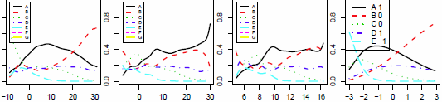
You are required to attend an early morning business meeting at a scientific conference. In the past you have had trouble keeping focused in these meetings and have had trouble staying alert through them. What is the most effective thing to do? (* = expert key)
Do what you can to stay awake, such as drinking coffee or sitting in the front row.* (38%) ___
Read the agenda and last years’ minutes ahead of time. (32%) ----
During the meeting read through the meeting materials. (11%) . . . .
Come to the conference caught up on your sleep.* (18%) ._._._.
Skip the meeting this year. (1%) ._._._
OCC
OCC
OCC
ICC
Expert Key Score
Popular Score
Consensus Score
NRM Score

Slide 69
You are required to attend an early morning business meeting at a scientific conference. In the past you have had trouble keeping focused in these meetings and have had trouble staying alert through them. What is the most effective thing to do? (* = expert key)
Do what you can to stay awake, such as drinking coffee or sitting in the front row.* (38%) ___
Read the agenda and last years’ minutes ahead of time. (32%) ----
During the meeting read through the meeting materials. (11%) . . . .
Come to the conference caught up on your sleep.* (18%) ._._._.
Skip the meeting this year. (1%) ._._._
OCC
ICC
The middle ability examinees agree with the experts, select option a
OCC
OCC
The highest ability examinees select option b (they disagree with the experts on this item)
Expert Key Score
Popular Score
Consensus Score
NRM Score

Slide 70
You are required to attend an early morning business meeting at a scientific conference. In the past you have had trouble keeping focused in these meetings and have had trouble staying alert through them. What is the most effective thing to do? (* = expert key)
Do what you can to stay awake, such as drinking coffee or sitting in the front row.* (38%) ___
Read the agenda and last years’ minutes ahead of time. (32%) ----
During the meeting read through the meeting materials. (11%) . . . .
Come to the conference caught up on your sleep.* (18%) ._._._.
Skip the meeting this year. (1%) ._._._
OCC
ICC
What if you don’t trust your experts?
Let x = what the crowd believes
OCC
OCC
Expert Key Score
Popular Score
Consensus Score
NRM Score

Slide 71
You are required to attend an early morning business meeting at a scientific conference. In the past you have had trouble keeping focused in these meetings and have had trouble staying alert through them. What is the most effective thing to do? (* = expert key)
Do what you can to stay awake, such as drinking coffee or sitting in the front row.* (38%) ___
Read the agenda and last years’ minutes ahead of time. (32%) ----
During the meeting read through the meeting materials. (11%) . . . .
Come to the conference caught up on your sleep.* (18%) ._._._.
Skip the meeting this year. (1%) ._._._
OCC
OCC
OCC
ICC
Expert Key Score
Popular Score
Consensus Score
NRM Score

Slide 72
You are required to attend an early morning business meeting at a scientific conference. In the past you have had trouble keeping focused in these meetings and have had trouble staying alert through them. What is the most effective thing to do? (* = expert key)
Do what you can to stay awake, such as drinking coffee or sitting in the front row.* (38%) ___
Read the agenda and last years’ minutes ahead of time. (32%) ----
During the meeting read through the meeting materials. (11%) . . . .
Come to the conference caught up on your sleep.* (18%) ._._._.
Skip the meeting this year. (1%) ._._._
OCC
ICC
OCC
Or, maybe better still, reflect the diversity of the crowd
Let x = what the crowd believes, proportionately
OCC
Expert Key Score
Popular Score
Consensus Score
NRM Score

Slide 73
You are required to attend an early morning business meeting at a scientific conference. In the past you have had trouble keeping focused in these meetings and have had trouble staying alert through them. What is the most effective thing to do? (* = expert key)
Do what you can to stay awake, such as drinking coffee or sitting in the front row.* (38%) ___
Read the agenda and last years’ minutes ahead of time. (32%) ----
During the meeting read through the meeting materials. (11%) . . . .
Come to the conference caught up on your sleep.* (18%) ._._._.
Skip the meeting this year. (1%) ._._._
OCC
OCC
OCC
ICC
Expert Key Score
Popular Score
Consensus Score
NRM Score

Slide 74
You are required to attend an early morning business meeting at a scientific conference. In the past you have had trouble keeping focused in these meetings and have had trouble staying alert through them. What is the most effective thing to do? (* = expert key)
Do what you can to stay awake, such as drinking coffee or sitting in the front row.* (38%) ___
Read the agenda and last years’ minutes ahead of time. (32%) ----
During the meeting read through the meeting materials. (11%) . . . .
Come to the conference caught up on your sleep.* (18%) ._._._.
Skip the meeting this year. (1%) ._._._
What parametric IRT model allows varying category slopes & intercepts and does not require knowing category order?
OCC
OCC
OCC
ICC
Expert Key Score
Popular Score
Consensus Score
NRM Score

Slide 75
You are required to attend an early morning business meeting at a scientific conference. In the past you have had trouble keeping focused in these meetings and have had trouble staying alert through them. What is the most effective thing to do? (* = expert key)
Do what you can to stay awake, such as drinking coffee or sitting in the front row.* (38%) ___
Read the agenda and last years’ minutes ahead of time. (32%) ----
During the meeting read through the meeting materials. (11%) . . . .
Come to the conference caught up on your sleep.* (18%) ._._._.
Skip the meeting this year. (1%) ._._._
OCC
OCC
OCC
OCC
Expert Key Score
Popular Score
Consensus Score
NRM Score

Slide 76
Study 1
Situational Test of Emotional Management for Youths
  11 items, 4 options
    MacCann & Roberts, 2008; Roberts & Burrus, 2012; Roberts, Brenneman, & Lipnevich, 2012
  N = 2048; middle-school students
Pick the best option
5 scoring methods
  number-correct; consensus, 2PL, GPCM, NRM (no key)
24 outcomes
  e.g., GPA, grades, personality, coping, teamwork, teachers’ evaluation
Software
  IRT: IRTPRO
  Factor analysis: Mplus (ESEM program)
  The rest: R

Slide 77
Reliability and Correlation
Scoring Scheme | Reliability | 1 | 2 | 3 | 4
1. Number-correct | .44 | --
2. 2PL | .52 | .89 | --
3. GPCM | .57 | .91 | .92 | -- | --
4. Consensus | .60 | .91 | .96 | .95
5. NRM | .63 | .69 | .81 | .84 | .85
NRM has the highest reliability
NRM is the most unique score

Slide 78
Correlations (between various SJT scores (on the same task) and some other factors
Factors | Number-correct | 2PL | Consensus | GPCM | NRM
6. Cooperation (“I like to work with people.”) | .28 | .32 | .35 | .34 | .40
10. Anxiety (“I give up easily.”) | -.25 | -.28 | -.30 | -.28 | -.32
12. Openness (“I enjoy homework”) | .21 | .24 | .25 | .26 | .33
13. Sympathy (“I think it is important to help people”) | .29 | .34 | .35 | .35 | .39
23. Teacher evaluation: emotion stability (“Overcomes challenges and setbacks”) | .29 | .34 | .36 | .35 | .42

Slide 79
Conclusion
When the key is ambiguous (Studies 1, 3)
  NRM is the best scoring method
    higher reliability; higher validities
  Among the two non-model based methods, consensus scoring is superior to number-correct scoring
When the key is clear (Study 2)
  No difference among scoring methods

Slide 80
Suggestions
Situational Judgment Tests are useful for capturing more context than typical personality items do
  But because of that they’re lower in reliability
  But meta-analyses (McDaniel et al) show that they add to personality tests (and cognitive tests) in predicting outcomes
NRM scoring is a way to improve data quality (increase reliability and validity)
  Also allows to use items that do not have an obvious “right answer”

Slide 81
General Conclusions
Anchoring vignettes, forced-choice, and situational judgment tests have proven useful in increasing data quality for “personality” tests
Along with other’s reports, these are perhaps the best ways to collect personality data today
The drawbacks are additional development time, additional testing time, and more complex analyses
These drawbacks may be small compared to the added value of these techniques

Slide 82
Thank you!
Jiyun Zu jzu@ets.org
Hongwen Guo hguo@ets.org
Jonas Bertling jbertling@ets.org
Paola Heincke pheincke@ets.org
Jacob Seybert jseybert@ets.org
Bobby Naemi bnaemi@ets.org

Slide 83
References
Birnbaum, A. (1968). Some latent trait models and their use in inferring an examinee=s ability. In F. M. Lord, & M. R. Novick (Eds.) Statistical theories of mental scores. Reading, MA: Addison-Wesley.
Bock, R. D. (1972). Estimating item parameters and latent ability when responses are scored in two or more nominal categories. Psychometrika, 37, 29—51.
Burrus, J., & Roberts, R.D. (2012). Elementary Schools Research Collaborative Mission Skills Assessment: Fall 2011 Assessment Report. Princeton, NJ: Center for Academic and Workforce Readiness and Success, Educational Testing Service.
Burrus, J., Roberts, R.D.. Brenneman, M., & Lipnevich, A. (2012). Elementary Schools Research Collaborative Preliminary Report of First Wave Mission Skills Assessment. Princeton, NJ: Center for Academic and Workforce Readiness and Success, Educational Testing Service.
MacCann, C., & Roberts, R. D. (2008). New paradigms for assessing emotional intelligence: Theory and data. Emotion, 8, 540-551.
MacCann, C., & Roberts, R. D. (2012). Just as smart but not as successful: Obese students obtain lower school grades but equivalent test scores to non-obese students. International Journal of Obesity, 1-7.
Oswald, Schmitt, Kim, Ramsay, Gillespie (2004). Developing a biodata measure and situational judgment inventory as predictors of college student performance. Journal of Applied Psychology, 89, 187-207.
Weekly, J. & Ployhart, R. (Eds.) (2006). Situational judgment test: Theory, measurement and application. Mahwah, NJ: Lawrence Erlbaum Associates.

Slide 84
References
¹ Connelly BS & Ones DS (2010). An other perspective on personality: meta-analytic integration of observers' accuracy and predictive validity. Psychol Bull, 136(6), 1092-1122.
Brown, A., & Bartram, D. (2009, April). Doing less but getting more: Improving forced-choice measures with IRT. Paper presented at the 24th annual conference of the Society for Industrial and Organizational Psychology, New Orleans, LA.
Salgado, J.F., & Táuriz, G. (2012): The Five-Factor Model, forced-choice personality inventories and performance: A comprehensive meta-analysis of academic and occupational validity studies, European Journal of Work and Organizational Psychology, DOI:10.1080/1359432X.2012.716198
Barrick & Mount, (1991). The Big Five personality dimensions and job performance: A meta-analysis. Personnel Psychology, 44, 1-26.
Buckley (2009). Cross-national response styles in international educational assessments: Evidence from PISA 2006. https://edsurveys.rti.org/PISA/documents/Buckley_PISAresponsestyle.pdf.
Cronbach, L.J. (1946). Response sets and test validity. Educational and Psychological Measurement, 6, 475-494.
He, J. (2014). The psychological meaning of survey response styles from a cross-cultural perspective (Unpublished doctoral dissertation). Tilburg University, the Netherlands.

Slide 85
References
He, J., Bartram, D, Inceoglu, I., & van de Vijver, F. (2014). Response Styles and Personality Traits: A Multilevel Analysis. Journal of Cross-cultural psychology. 0022022114534773
Hopkins, D., & King, G. (2010). Improving Anchoring Vignettes: Designing Surveys to Correct Interpersonal Incomparability. Public Opinion Quarterly: 1-22. Copy at http://j.mp/jVFIVg
Khorramdel, L., & von Davier, M. (2014). Measuring response styles across the Big Five: A multiscale extension of an approach using multinomial processing trees. Multivariate Behavioral Research, 49(2), 161-177.
King, G., Christopher JL ,Murray, C.J.L., Salomon, J.A., & Tandon, A. (2004). Enhancing the Validity and Cross-cultural Comparability of Measurement in Survey Research. American Political Science Review 98: 191–207
King, G., & Wand, J. (2007). Comparing incomparable survey responses: Evaluating and selecting anchoring vignettes. Political Analysis 15, 46-66.
Kyllonen, P., Zu, J., & Guo, H. (2014). Exploiting the Wisdom of the Wise Crowd to Score Items With Fuzzy Keys: Nominal Response Model Scoring of Situational Judgment Tests. New directions in personality assessment. Psychometric Society, annual meeting, Madison, WI.

Slide 86
References
Kyllonen & Bertling, 2013). Innovative questionnaire assessment methods to increase cross-country comparability. In L. Rutkowski, M. von Davier, & D. Rutkowski, (eds.) Handbook of International Large-Scale Assessment: Background, Technical Issues, and Methods of Data Analysis. Boca Raton: CRC Press.
Likert, R. (1932). A technique for the measurement of attitudes. Archives of Psychology 140.
Marsh, H. W., Hau, K.T. (2004). Explaining paradoxical relations between academic self-concepts and achievements: Cross-cultural generalizability of the internal/external frame of reference predictions across 26 countries. Journal of Educational Psychology, 96(1), 56-67.
Mottus, R., Allik, J., Realo, A., Rossier, J., Zecca, G., Ah-Kion, J. et al. (2012). The effect of response style on self-reported conscientiousness across 20 countries. Personality and Social Psychology Bulletin, 38, 1423-1436.
Poropat, A. E. (2009). A meta-analysis of the five-factor model of personality and academic performance. Psychological Bulletin, 135(2), 322-338. doi: 10.1037/a0014996.

Slide 87
References
Smith, P. B., & Fischer, R. (2008). Acquiescence, extreme response bias and culture: A multilevel analysis. In F. J. R. van de Vijver, D. A. van Hemert & Y. H. Poortinga (Eds.), Multilevel analysis of individuals and cultures (pp. 285-314). New York, NY: Taylor & Francis Group/Lawrence Erlbaum Associates.
Van de gaer, E., Grisay, A., Schulz, W., & Gebhardt, E. (2012). The reference group effect: An explanation of the paradoxical relationship between academic achievement and self-confidence across countries. Journal of Cross-Cultural Psychology, 43(8),1205-1228.
Van Vaerenbergh, Y., & Thomas, T. D. (2012). Response styles in survey research: A literature review of antecedents, consequences, and remedies. International Journal of Public Opinion Research. doi:10.1093/ijpor/eds021
Vonkova, H., Zamarro, G., Deberg, V. (2015). Comparisons of Student Perceptions of Teacher’s Performance in the Classroom: Using Parametric Anchoring Vignette Methods for Improving Comparability.
Hana Vonkova*, Jan Hrabak (2015). The (in) comparability of ICT knowledge and skill self-assessments among upper secondary school students: The use of the anchoring vignette method. Computers & Education 85, 191-202.

