Slide 1
What Do Test Scores Miss? The Importance of Teacher Effects on Non-Test Score Outcomes
C. Kirabo Jackson
Northwestern University and NBER

Slide 2
Motivation
At the broadest level, a quality teacher is one that teaches students the skills needed to be productive adults (Douglass 1958; Jackson et. al. 2014).
Economists have historically focused on test-score measures of teacher quality (value-added) because standardized tests are often the best available measure of student skills.
Having a teacher at the 85th versus the 15th percentile of the test score value-added distribution is found to increase test score by between 8 and 20 percentile points (Kane and Staiger, 2008; Rivkin, Hanushek, and Kain, 2005).
Chetty, Friedman, and Rockoff (2014b) show that teachers who improve test scores improve students’ longer run outcomes such as high school completion, college-going, and earnings.

Slide 3
A large body of research demonstrates that “noncognitive” skills not captured by standardized tests, such as adaptability, self-restraint, and motivation, are key determinants of adult outcomes.
See Heckman, Stixrud, and Urzua 2006; Lindqvist and Vestman, 2011; Heckman and Rubinstein, 2001; Waddell, 2006; Borghans, Weel, and Weinberg, 2008.
This literature provides reason to suspect that teachers may impact skills that go undetected by test scores, but are nonetheless important for students’ long run success.
Some interventions that have no effect on test scores have meaningful effects on long-term outcomes (Booker et al. 2011; Deming, 2009; Deming, 2011)
Improved noncognitive skills explain the effect of some interventions (Heckman, Pinto, and Savelyev 2013; Fredricksson et al 2012).

Slide 4
Objectives
Extend the value-added model to one where student ability has both cognitive and a non-cognitive dimensions.
We can obtain a better prediction of teacher effects on long-run outcomes using effects on multiple skill measures that reflect different mixes of skills.
Use non-test score skill measures (behaviors) to form a proxy for skills not well measured by standardized tests, and demonstrate the extent to which it predicts adult outcomes conditional on test scores.
The logic of using behaviors to infer noncognitive skills…..
Estimate 9th grade Math and English teacher effects on both test-scores and behaviors.
Investigate how well test-score measures and non-test score measures of teacher quality predict teacher effects on longer-run outcomes.

Slide 5
Data
All 9th grade public school students in North Carolina from 2005 - 2012.
Demographic characteristics, transcript data, middle-school achievement, end of course scores for Math and English courses, suspensions, and absences.
Students are linked to their individual teachers via matching.
The 2005 through 2011 9th grade cohorts are linked to dropout, graduation and SAT outcomes.
I limit the analysis to students who took Math (Algebra I, Geometry, Algebra II) and English I (roughly 94% of all 9th graders ).
Based on the first time a student is observed in ninth grade.
Data cover 573,963 ninth graders in 872 schools in classes with 5,195 English teachers and 6,854 math teachers.
Data are stacked across both subjects.

Slide 6
Proxying for Skills Not Measured by Standardized Tests
Behaviors can proxy for “soft” skills (e.g. Heckman et al 2006, Lleras 2008, Bertrand and Pan 2013, Kautz 2014).
I use the log of absences in 9th grade, if suspended during 9th grade, 9th grade GPA (all courses), and whether they enrolled in 10th grade on time.
To assuage worries of mechanical relationships, I also use 10th grade GPA.
These outcomes are strongly associated with well-known psychometric measures of noncognitive skills including the “big five” and grit.
Similar to Heckman, Stixrud, and Urzua (2006), I use a principal components model to create a single index of these behaviors.
➔Behavioral Factor
This also accounts for measurement error in each of them. This index is a weighted average of the non-test-score outcomes, and is standardized.
The behavioral factor has a correlation of 0.5 with test scores.

Slide 7
Do Behaviors Measure Skills not Measured by Test Scores?
Table 2: Predicting Long-Run Outcomes Using Ninth-Grade Skill Measures
 | Main Longer-run Outcomes
 | Drop out | Graduate
Grade Point Average (9th grade) | -0.0353** | 0.0933**
 | [0.000760] | [0.00126]
Log of # Absences+1 (9th grade) | 0.00635** | -0.0198**
 | [0.000317] | [0.000552]
Suspended (9th grade) | 0.0177** | -0.0503**
 | [0.00225] | [0.00339]
On time in 10th grade | -0.0761** | 0.337**
 | [0.00188] | [0.00301]
Math z-score (9th grade) | -0.00427** | 0.00691**
 | [0.000443] | [0.000794]
English z-score (9th grade) | -0.00539** | 0.00503**
 | [0.000659] | [0.00112]
Observations | 439,284 | 439,284
In addition to school fixed effects and year fixed effects, all models include controls for student gender, ethnicity, parental education, a cubic function of Math and Reading test scores in seventh and eighth grade, suspension in seventh and eighth grade, days absent in seventh and eighth grade, GPA in eighth grade [for high-school courses only], and whether the student had repeated seventh or eighth grade. Individuals with no eighth-grade GPA are imputed a value of 2.5.
** p<0.01, * p<0.05, + p<0.1 Robust standard errors in brackets.

Slide 8
Using Averages of the Skill Measures
Table 2: Predicting Long Run Effect Using 9th Grade Outcomes (short version)
 | 3 | 4 |  | 5 | 6 | 7
 | Drop out | Graduate |  | High School GPA at Graduation | Take SAT | Intend 4yr
Average Test Scores z-score | -0.0133** | 0.0186** |  | 0.151** | 0.0465** | 0.0341**
 | [0.000747] | [0.00113] |  | [0.00151] | [0.00128] | [0.00115]
Behavioral factor z-score | -0.0524** | 0.158** |  | 0.345** | 0.130** | 0.0743**
 | [0.000588] | [0.000781] |  | [0.00128] | [0.000728] | [0.000645]
Observations | 527,571 | 527,571 |  | 403,672 | 468,015 | 468,015
Robust standard errors in brackets. ** p<0.01, * p<0.05, + p<0.1 If any one skill measure is missing, the average of all the other measures is used. The sample sizes are larger than with the individual skill measures because observations with any single missing skill measure of dropped when all are included.

Slide 9
Replicating Similar Patterns in Nationally Representative Data (NELS-88)
 | Dataset: National Educational Longitudinal Survey 1988
 | Dropout | Graduate | College (by age 25) | Arrests (by age 25) | Working (at age 25) | Log Income (at age 25)
Test-score index: z-score | -0.00923** | 0.00304 | 0.0522** | 0.0151* | 0.0131** | 0.144**
 | [0.00256] | [0.00407] | [0.00575] | [0.00610] | [0.00506] | [0.0506]
Behavior index: z-score | -0.0482** | 0.0933** | 0.0955** | -0.0559** | 0.0200** | 0.246**
 | [0.00339] | [0.00442] | [0.00533] | [0.00566] | [0.00470] | [0.0467]
School Fixed Effects | Y | Y | Y | Y | Y | Y
Covariates | Y | Y | Y | Y | Y | Y
Observations | 10,792 | 10,792 | 10,792 | 10,792 | 10,792 | 10,792
Robust standard errors in brackets
All models control for ethnicity, gender, family income, family size, and school fixed effects. ** p<0.01, * p<0.05, + p<0.1

Slide 10
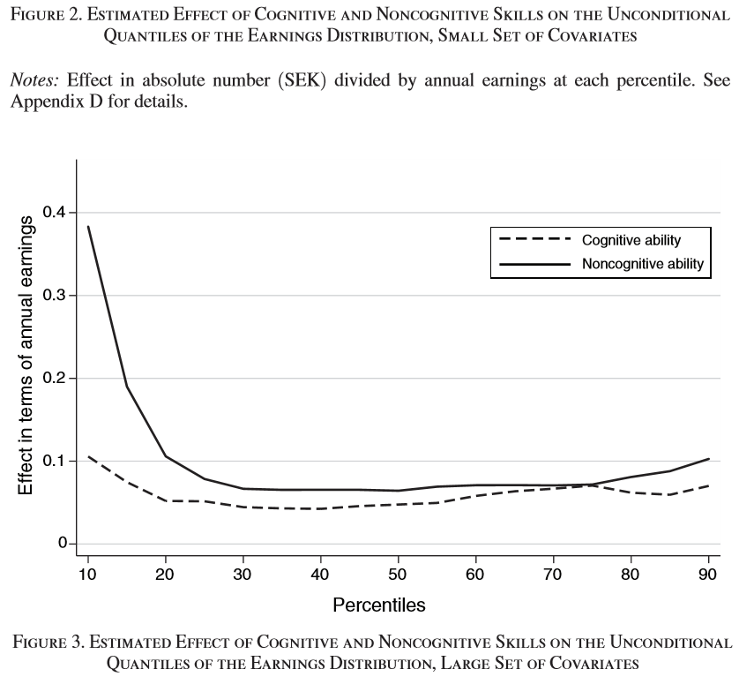
From Lindqvist and Vestman (2011) using Swedish data.

Slide 11
Replicating Behaviors of Psychometric Measures of Noncognitive Skills

Slide 12
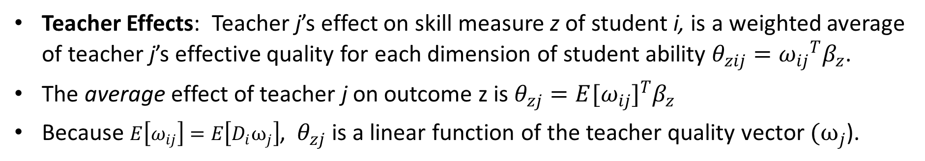

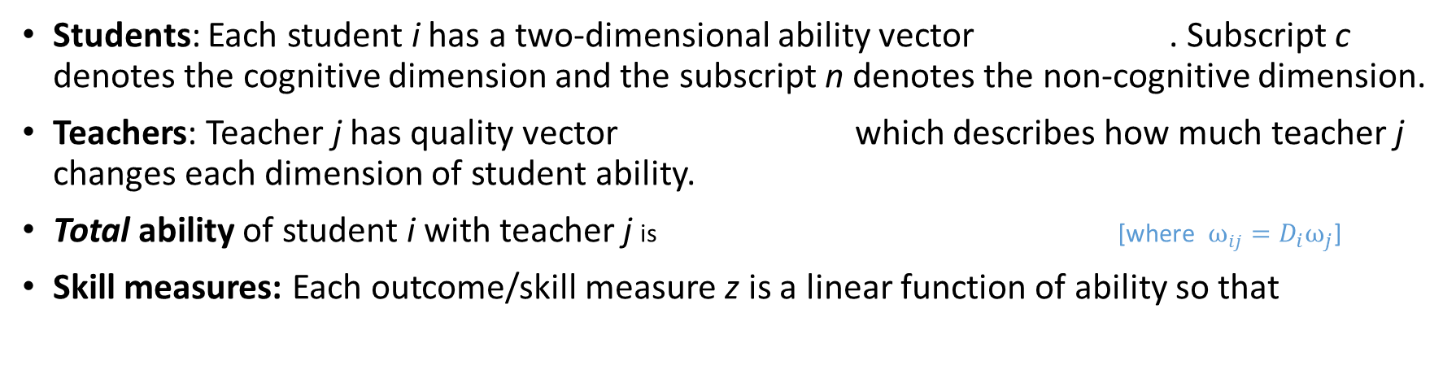


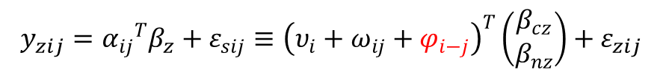
Theoretical Framework
$$ν_{i}={\left(ν_{ci},ν_{ni}\right)}^{T}$$
Students: Each student i has a two-dimensional ability vector . Subscript c denotes the cognitive dimension and the subscript n denotes the non-cognitive dimension.
Teachers: Teacher j has quality vector which describes how much teacher j changes each dimension of student ability.
Total ability of student i with teacher j is [where $ω_{ij}=D_{i}ω_{j}$]
Skill measures: Each outcome/skill measure z is a linear function of ability so that
$ω_{j}={(ω_{cj},ω_{nj})}^{T}$
Contribution of other teachers
$$α_{ij}=υ_{i}+ω_{ij }+φ_{i−j}$$
$$y_{zij}={α_{ij}}^{T}β_{z}+ε_{sij}≡{\left(υ_{i}+ω_{ij}+φ_{i−j}\right)}^{T}\left(\begin{matrix}β_{cz} \\ β_{nz}\end{matrix}\right)+ε_{zij}$$
Teacher Effects: Teacher j’s effect on skill measure z of student i, is a weighted average of teacher j’s effective quality for each dimension of student ability $θ_{zij}={ω_{ij}}^{T}β_{z}$.
The average effect of teacher j on outcome z is $θ_{zj}=E{[ω_{ij}]}^{T}β_{z}$
Because $E\left[ω_{ij}\right]=E\left[D_{i}ω_{j}\right]$, $θ_{zj}$ is a linear function of the teacher quality vector $(ω_{j}$).

Slide 13
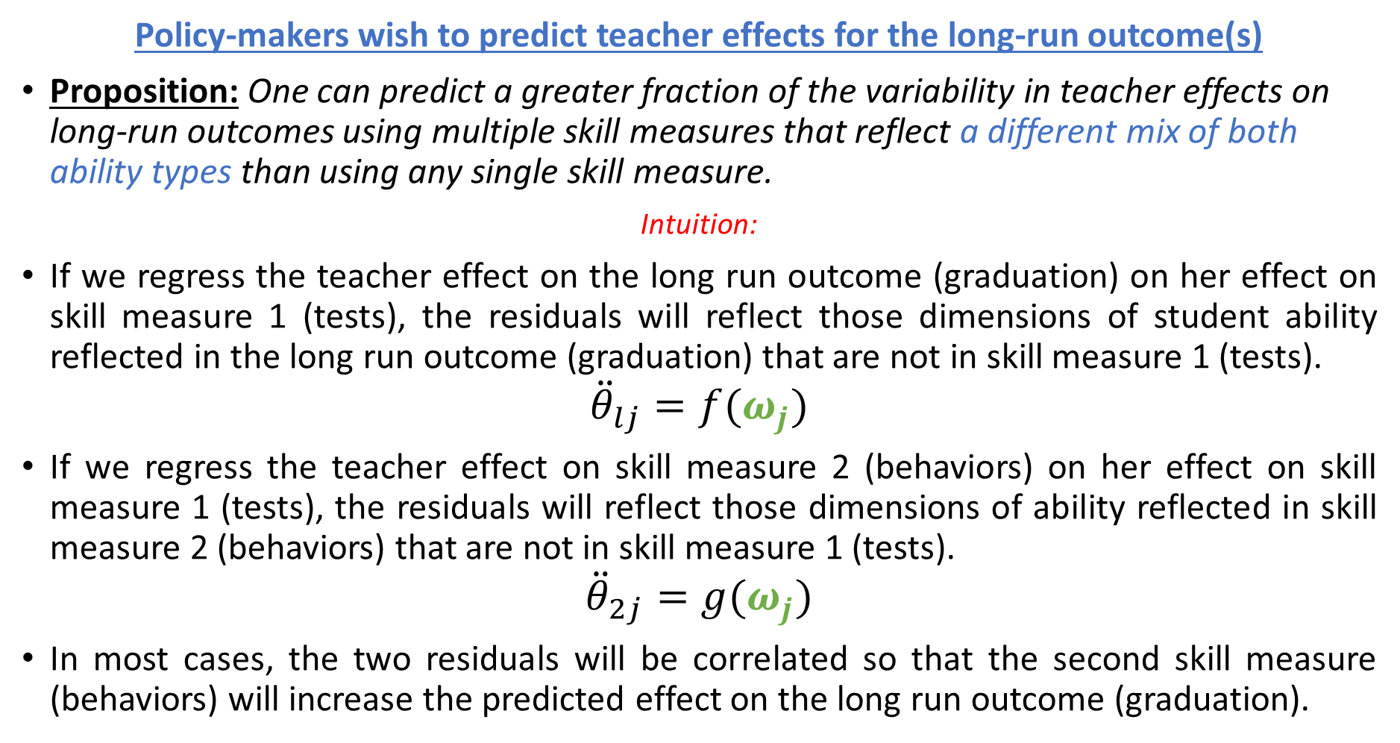
Policy-makers wish to predict teacher effects for the long-run outcome(s)
Proposition: One can predict a greater fraction of the variability in teacher effects on long-run outcomes using multiple skill measures that reflect a different mix of both ability types than using any single skill measure.
Intuition:
If we regress the teacher effect on the long run outcome (graduation) on her effect on skill measure 1 (tests), the residuals will reflect those dimensions of student ability reflected in the long run outcome (graduation) that are not in skill measure 1 (tests).
$${\ddot{θ}}_{lj}=f(ω_{j})$$
If we regress the teacher effect on skill measure 2 (behaviors) on her effect on skill measure 1 (tests), the residuals will reflect those dimensions of ability reflected in skill measure 2 (behaviors) that are not in skill measure 1 (tests).
$${\ddot{θ}}_{2j}=g(ω_{j})$$
In most cases, the two residuals will be correlated so that the second skill measure (behaviors) will increase the predicted effect on the long run outcome (graduation).

Slide 14
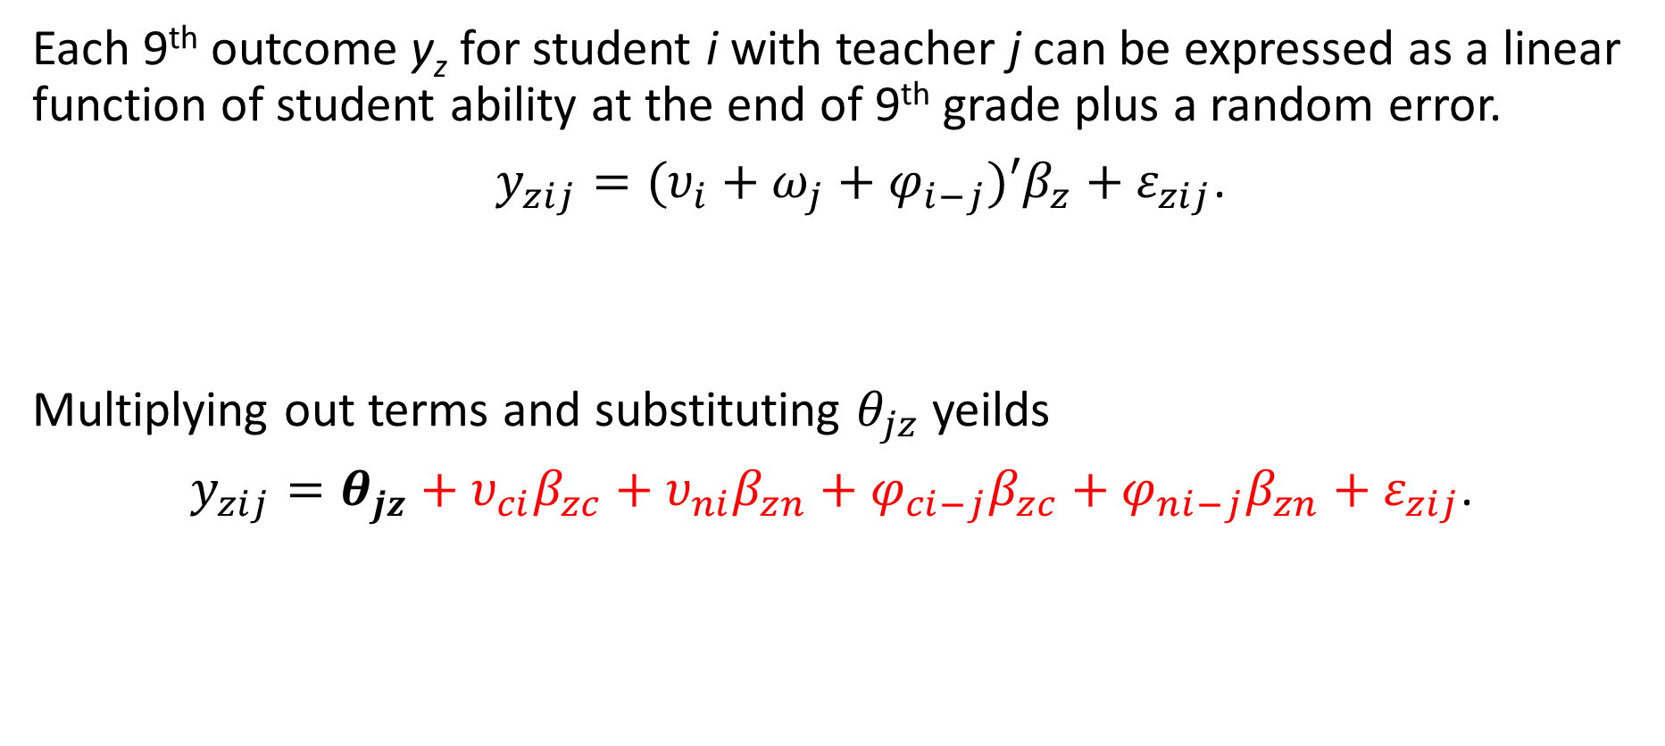
Deriving an Empirical Model From the Theory
Each 9th outcome y_{z} for student i with teacher j can be expressed as a linear function of student ability at the end of 9th grade plus a random error.
$y_{zij}=(υ_{i}+ω_{j}+φ_{i−j})′β_{z}+ε_{zij}$.
Multiplying out terms and substituting $θ_{jz}$ yeilds
$y_{zij}=θ_{jz}+υ_{ci}β_{zc}+υ_{ni}β_{zn}+φ_{ci−j}β_{zc}+φ_{ni−j}β_{zn}+ε_{zij}$.
Contribution of
Incoming ability
Contribution
of other teachers

Slide 15
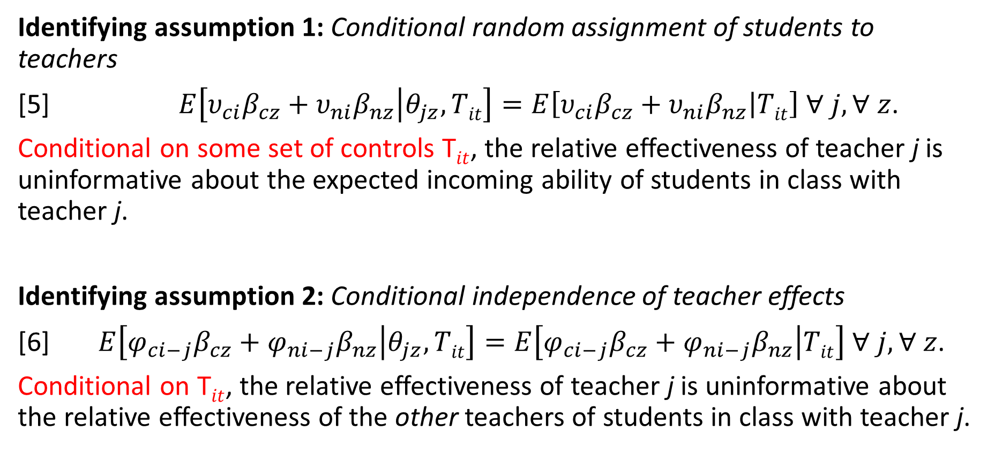
Identifying Assumptions for $θ_{jz}$
Identifying assumption 1: Conditional random assignment of students to teachers
[5] $E\left[υ_{ci}β_{cz}+υ_{ni}β_{nz} | θ_{jz},Tit\right]=E\left[υ_{ci}β_{cz}+υ_{ni}β_{nz} | Tit\right] ∀ j,∀ z$.
Conditional on some set of controls T$it$, the relative effectiveness of teacher j is uninformative about the expected incoming ability of students in class with teacher j.
Identifying assumption 2: Conditional independence of teacher effects
[6] $E\left[φ_{ci−j}β_{cz}+φ_{ni−j}β_{nz} | θ_{jz},Tit\right]=E\left[φ_{ci−j}β_{cz}+φ_{ni−j}β_{nz} | Tit\right] ∀ j,∀ z$.
Conditional on T$it$, the relative effectiveness of teacher j is uninformative about the relative effectiveness of the other teachers of students in class with teacher j.

Slide 16
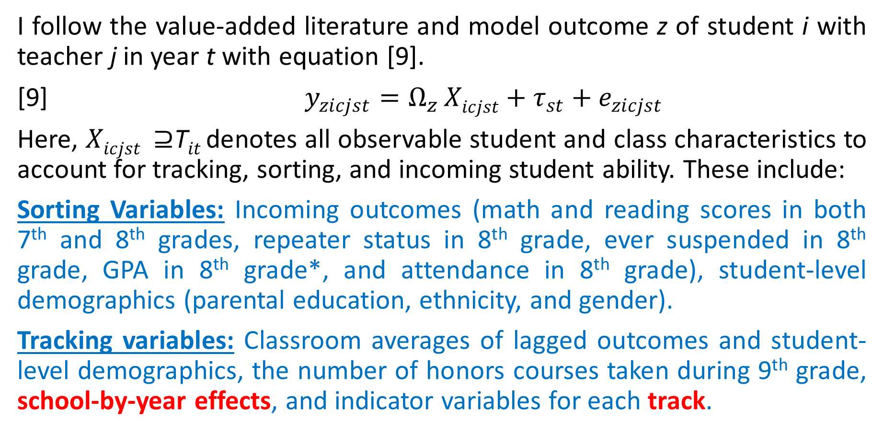
Estimating Teacher Effects on 9th Grade Skill Measures
I follow the value-added literature and model outcome z of student i with teacher j in year t with equation [9].
[9] $y_{zicjst}=Ω_{z }Xicjst+{τ_{st}+e}_{zicjst}$
Here, $Xicjst ⊇$T$it$denotes all observable student and class characteristics to account for tracking, sorting, and incoming student ability. These include:
Sorting Variables: Incoming outcomes (math and reading scores in both 7th and 8th grades, repeater status in 8th grade, ever suspended in 8th grade, GPA in 8th grade*, and attendance in 8th grade), student-level demographics (parental education, ethnicity, and gender).
Tracking variables: Classroom averages of lagged outcomes and student-level demographics, the number of honors courses taken during 9th grade, school-by-year effects, and indicator variables for each track.

Slide 17
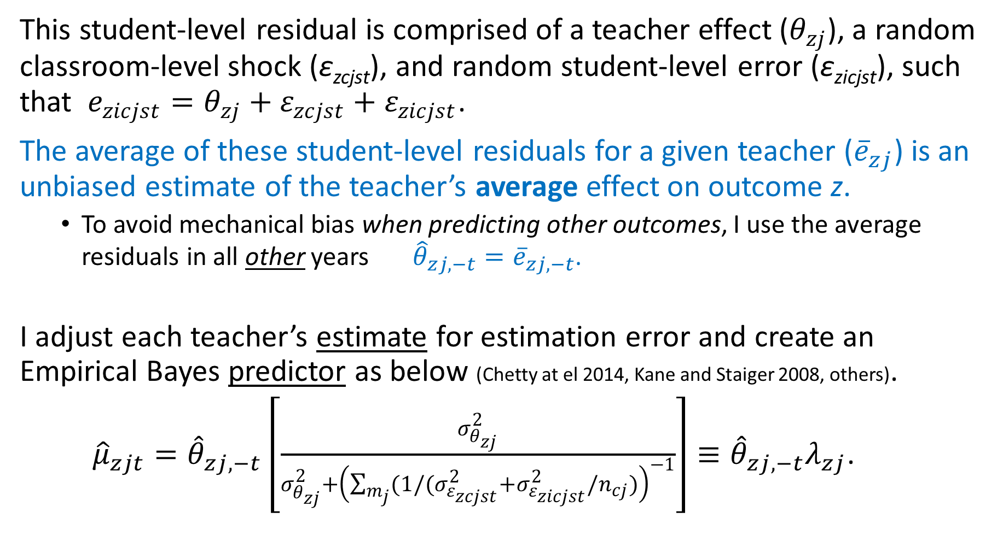
This student-level residual is comprised of a teacher effect ($θ_{zj}$), a random classroom-level shock (ε_{zcjst}), and random student-level error (ε_{zicjst}), such that $e_{zicjst}=θ_{zj}+ε_{zcjst}+ε_{zicjst}$.
The average of these student-level residuals for a given teacher (${\overline{e}}_{zj}$) is an unbiased estimate of the teacher’s average effect on outcome z.
To avoid mechanical bias when predicting other outcomes, I use the average residuals in all other years ${\hat{θ}}_{zj,−t}={\overline{e}}_{zj,−t}$.
I adjust each teacher’s estimate for estimation error and create an Empirical Bayes predictor as below (Chetty at el 2014, Kane and Staiger 2008, others).
${\hat{μ}}_{zjt}={\hat{θ}}_{zj,−t}\left[\frac{σ_{θ_{zj}}^{2}}{σ_{θ_{zj}}^{2}+{\left(\sum_{m_{j}}{(1/(σ_{ε_{zcjst}}^{2}+σ_{ε_{zicjst}}^{2}/n_{cj})}\right)}^{−1}}\right]≡{\hat{θ}}_{zj,−t}λ_{zj}$.
Signal to noise ratio

Slide 18
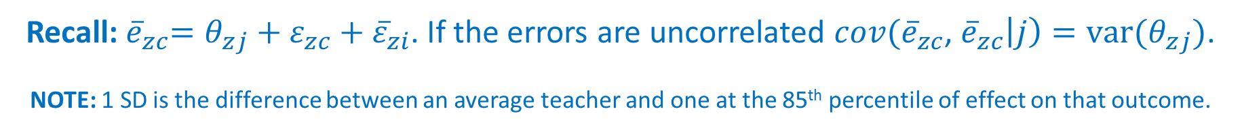
Magnitudes of Estimated Effects on Skill Measures
Recall:${ \overline{e}}_{zc}=θ_{zj}+ε_{zc}+{\overline{ε}}_{zi}$. If the errors are uncorrelated ${cov(\overline{e}}_{zc}$, ${\overline{e}}_{zc}\left|j\right)=var(θ_{zj})$.
NOTE: 1 SD is the difference between an average teacher and one at the 85th percentile of effect on that outcome.
Covariance-Based Estimates of the Variability of Persistent Teacher Effects
 | All Teachers
 | English Score | Math Score | Suspended | Log absences | 9th Grade GPA | In 10th on time | Behaviors Index | 10th Grade GPA
English Teachers SD | 0.0301 | 0.0292 | 0.0104 | 0.0434 | 0.0415 | 0.0212 | 0.0552 | 0.0360
Math Teachers SD | 0.0204 | 0.0844 | 0.0121 | 0.0001 | 0.0632 | 0.0264 | 0.0801 | 0.0501
All Teachers SD | 0.018 | 0.0751 | 0.0108 | 0.02839 | 0.0446 | 0.0247 | 0.0769 | 0.0315
Note: The estimated standard deviations are the estimated covariances in mean residuals from equation [9] across classrooms for the same teacher. Specifically, I pair each classroom with a randomly chosen different classroom for the same teacher and estimate the covariance. I replicate this 200 times and report the median estimated covariance as the parameter estimate.

Slide 19
Do Teacher Effects on Test Scores and Effects on Behaviors Measure the Same Thing?

Slide 20
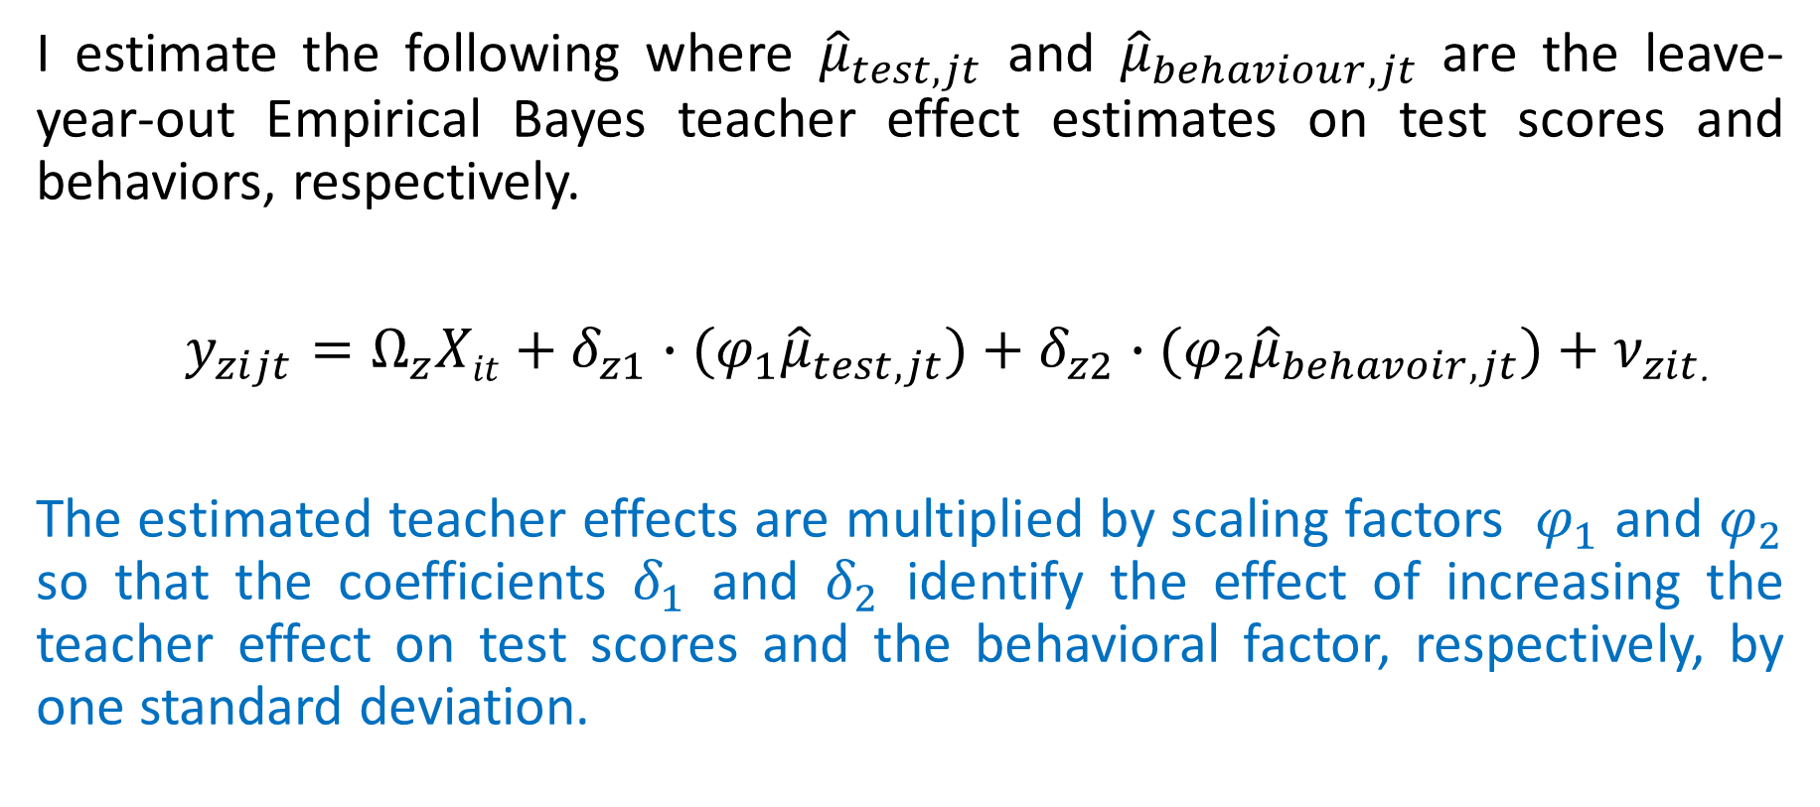
Predicting Test Scores and Behaviors Using Teacher Effects from Out-of-Sample
I estimate the following where ${\hat{μ}}_{test,jt}$ and ${\hat{μ}}_{behaviour,jt}$ are the leave-year-out Empirical Bayes teacher effect estimates on test scores and behaviors, respectively.
$y_{zijt}={Ω_{z}Xit+δ_{z1}∙(φ_{1}\hat{μ}}_{test,jt})+{δ_{z2}∙(φ_{2}\hat{μ}}_{behavoir,jt})+ν_{zit}$.
The estimated teacher effects are multiplied by scaling factors $φ_{1}$ and $φ_{2}$ so that the coefficients $δ_{1}$ and $δ_{2}$ identify the effect of increasing the teacher effect on test scores and the behavioral factor, respectively, by one standard deviation.

Slide 21
Teacher Effects on Behaviors Measure Skills not Measured by Test Scores (Math and English combined) (a)
 | 1 | 2 | 3 | 4 | 5
 | Test Score in 9th Grade
Teacher Effect: 9th Grade Test Score | 0.0685** |  | 0.0690** |  | 0.0685**
 | [0.00279] |  | [0.00281] |  | [0.00281]
Teacher Effect: 9th Grade Behaviors |  | 0.0274* | -0.0214+
 |  | [0.0124] | [0.0128]
Teacher Effect: 10 Grade GPA |  |  |  | 0.0987** | 0.00115
 |  |  |  | [0.0230] | [0.0206]
School-Track Effects | Y | Y | Y | Y | Y
Year Effects | Y | Y | Y | Y | Y
Controls | Y | Y | Y | Y | Y
Observations | 942,291 | 942,291 | 942,291 | 942,291 | 942,291
Robust standard errors in brackets adjusterd for clustering at the teacher level and students level.
** p<0.01, * p<0.05, + p<0.1

Slide 22
Teacher Effects on Behaviors Measure Skills not Measured by Test Scores (Math and English combined)(b)
 | 6 | 7 | 8 |  | 9 | 10 | 11
 | Behaviors in 9th Grade |  |  |  | GPA in 10th Grade
Teacher Effect: 9th Grade Test Score | 0.0074** |  | 0.0061** |  | 0.0042** |  | 0.0038**
 | [0.00161] |  | [0.00156] |  | [0.00119] |  | [0.00119]
Teacher Effect: 9th Grade Behaviors |  | 0.0579** | 0.0536**
 |  | [0.0106] | [0.0107]
Teacher Effect: 10 Grade GPA |  |  |  |  |  | 0.0357* | 0.0298*
 |  |  |  |  |  | [0.0147] | [0.0149]
School-Track Effects | Y | Y | Y |  | Y | Y | Y
Year Effects | Y | Y | Y |  | Y | Y | Y
Controls | Y | Y | Y |  | Y | Y | Y
Observations | 942,291 | 942,291 | 942,291 |  | 728,529 | 728,529 | 728,529
Robust standard errors in brackets adjusterd for clustering at the teacher level and students level.
** p<0.01, * p<0.05, + p<0.1

Slide 23
Effects of Teachers on Skill Measures and their Effects on High-School Completion (a)
 | Graduate High School
 | Linear Probability Model |  |  |  | Conditional Logit ^{b}
Teacher Effect: 9th Grade Test Score | 0.0015** | 0.0012* | 0.0013* |  | 0.0088 | 0.01
 | [0.0005] | [0.00054] | [0.0005] |  | [0.0064] | [0.0064]
 |  |  |  |  | -0.002 | -0.0023
Teacher Effect: 9th Grade Behaviors |  | 0.0146** |  |  | 0.1442**
 |  | [0.00319] |  |  | [0.0343]
 |  |  |  |  | -0.0331
Teacher Effect: 10th Grade GPA |  |  | 0.0146** |  |  | 0.162**
 |  |  | [0.0056] |  |  | [0.0637]
 |  |  |  |  |  | -0.0375
% Increase in explained variance |  | 305% | 97%
School-Track Effects | Y | Y | Y |  | Y | Y
Year Effects | Y | Y | Y |  | Y | Y
Controls | Y | Y | Y |  | Y | Y
Observations | 891,868 | 891,868 | 891,868 |  | 579,512 | 579,512
Note: Robust standard errors in brackets adjusted for two-way clustering at both the teacher level and student level.

Slide 24
Effects of Teachers on Skill Measures and their Effects on High-School Completion (b)
 | Dropout of High School
 | Linear Probability Model |  |  |  | Conditional Logit ^{b}
Teacher Effect: 9th Grade Test Score | -0.0004 | -0.0003 | -0.0004 |  | -0.0055 | -0.0084
 | [0.0003] | [0.0003] | [0.0003] |  | [0.0099] | [0.0101]
 |  |  |  |  | (-0.0012) | (-0.0018)
Teacher Effect: 9th Grade Behaviors |  | -0.0041* |  |  | -0.128*
 |  | [0.0019] |  |  | [0.0583]
 |  |  |  |  | (-0.0271)
Teacher Effect: 10th Grade GPA |  |  | -0.0031 |  |  | -0.0618
 |  |  | [0.0031] |  |  | [0.0996]
 |  |  |  |  |  | ( -0.012)
% Increase in explained variance |  | 326% | 59%
School-Track Effects | Y | Y | Y |  | Y | Y
Year Effects | Y | Y | Y |  | Y | Y
Controls | Y | Y | Y |  | Y | Y
Observations | 891,868 | 891,868 | 891,868 |  | 570,390 | 570,390
Note: Robust standard errors in brackets adjusted for two-way clustering at both the teacher level and student level.

Slide 25
Effects On Other Subsequent Outcomes

Slide 26
Effects By Subject (suggestive)

Slide 27
Testing Identifying Assumption 1: No Student Selection
Testing for selection on observables:
Create predicted outcomes using (gender, ethnicity, parental education, 7th grade test scores, grade absences, grade repetition, and suspensions).
See if estimated effects predict changes in predicted outcomes conditional on 8th grade outcomes and controls for tracking.
Under no selection, the coefficient on the teacher effects will be zero.
Testing for selection on unobservables:
Following Chetty et al (2014), aggregate the treatment to the school-year level to avoid comparisons across individuals within a school cohort.
This relies on variation across cohorts in average teacher quality.
Changes in average teacher quality at a school are due to personnel changes.
Use the average estimated teacher predictors as instruments.
Models include school-specific linear trends!

Slide 28
Effects on actual outcomes
Effects on predicted outcomes

Slide 30
Testing Identifying Assumption 2: No Confounding by Other Teachers
Table G3: Correlations between English and Math Teacher Effects
 | Math Teacher: Test Score Effect | Math Teacher: Behaviors Effect | Math Teacher: 10th Grade GPA Effect | English Teacher: Test Score Effect | English Teacher: Behaviors Effect | English Teacher: 10th Grade GPA Effect
Math Teacher: Test Score Effect | 1
Math Teacher: Behaviors Effect | 0.2582 | 1
Math Teacher: 10th Grade GPA Effect | 0.2144 | 0.3391 | 1
English Teacher: Test Score Effect | 0.0088 | -0.0018 | 0.0022 | 1
English Teacher: Behaviors Effect | 0.0102 | 0.0078 | -0.0064 | 0.1292 | 1
English Teacher: 10th Grade GPA Effect | -0.0032 | 0.0056 | 0.0087 | 0.1093 | 0.2067 | 1

Slide 31
Table G4: Relationship between English and Math Teacher Effects within Tracks
 | 1 | 2 | 3 | 4 | 5 | 6
 | Math Teacher: Test Score Effect | Math Teacher: Behaviors Effect | Math Teacher: 10th Grade GPA Effect | Math Teacher: Test Score Effect | Math Teacher: Behaviors Effect | Math Teacher: 10th Grade GPA Effect
English Teacher: Test Score Effect | 0.00572 |  |  | 0.00545
 | [0.00457] |  |  | [0.00457]
English Teacher: Behaviors Effect |  | -0.000266 |  |  | -0.000261
 |  | [0.00100] |  |  | [0.00100]
English Teacher: 10th Grade GPA Effect |  |  | -0.00298 |  |  | -0.00286
 |  |  | [0.00288] |  |  | [0.00289]
Year Effects | Y | Y | Y | Y | Y | Y
School-Track Effects | Y | Y | Y | Y | Y | Y
Controls | N | N | N | Y | Y | Y
Observations | 348,514 | 348,514 | 348,514 | 346,223 | 346,223 | 346,223
Robust standard errors in brackets
** p<0.01, * p<0.05, + p<0.1
Also, models that include other teacher fixed effects are virtually identical (Table G5).

Slide 32
Is This Mechanical Due to an Easy Grading Effect?
There is no mechanical relationship between grades or reporting bad behaviors and taking the SAT, or four-year college plans. However, teacher effects on behaviors predict effects on these 12th grade outcomes.
Teacher effects on outcomes such as suspensions (which are used to form the factor but have no mechanical association with graduation or dropout) independently predict effects on longer-run outcomes.
Using a teacher’s effect on GPA in 10th grade (where there is no direct interaction) an a proxy for effect on noncognitive skills yields similar results.

Slide 33
Are the Effects Driven by a lack of full controls for GPA in 8th Grade?

Slide 34
Observable Predictors

Slide 35
Possible Uses for Policy
Using observable teacher characteristics to identify excellent teachers may provide limited benefits.
Because some of the outcomes that form the behavioral factor (such as grades and suspensions) can be easily manipulated, attaching external stakes to the factor may not improve students skills (even if the measured outcomes do improve). However….
One can incentivize other measures of non-cognitive skills that are difficult to adjust (e.g. classroom observations and student and parent surveys).
One can identify teaching practices that cause improvements in the behavioral factor and encourage teachers to use these practices (through evaluation, training, or incentive pay).
One can incentivize behaviors in the following year.

Slide 36
Conclusions
This paper presents a model such that all student outcomes are a function of both student cognitive and non-cognitive ability.
One can use a mix of short run outcomes (that measure a different set of skills) to estimate a teacher’s predicted effect on longer-run outcomes.
Teachers have economically important causal effect on test scores and behaviors.
Test score effects only detect a small share of a teachers effect on the behavioral factor and vice versa.
Effects on the factor reflect skills unmeasured by test scores.
Including non-test score outcomes improves our ability to predict effects on longer outcomes substantially.
The effects appear to reflect real improvement in skills.

