Slide 1

Measuring and Assessing Skills 2017
University of Chicago

Slide 2
A diversity in skills is an old idea
Arithmetic, grammar, and the other rudiments, as they are called, comprise but a small part of the teachings in a school. The rudiments of feeling are taught not less than the rudiments of thinking. The sentiments and passions get more lessons than the intellect.
-Mann (1867, p. 420)

Slide 3
The rise in achievement tests
Despite a common sense idea that many skills matter, we came to rely on achievement tests to assess students, teachers, schools, and even countries
They were cost-effective
Implicit assumption that they captured most of the skills that matter in life

Slide 4
The hard evidence is new
A growing body of evidence has shown the importance of skills not captured by traditional measures of skill like IQ tests or achievement tests
These measures are predictive of later life outcomes and can be influenced by interventions
This type of evidence has captured the attention of policy-makers who need reliable ways to track progress

Slide 5
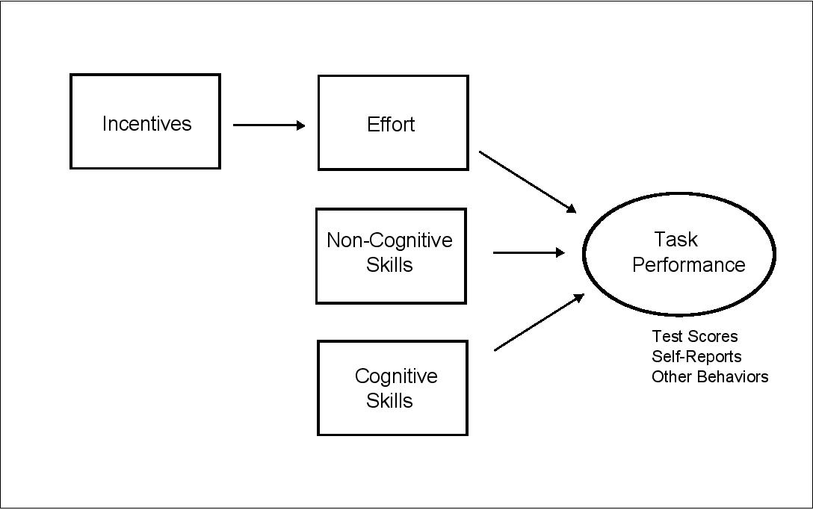
The task is not easy

Slide 6
Five main questions
How predictive are elicited measurements of skill of both short-run and long-run outcomes?
How important are incentives and contexts in the measurement of skills?
Do differences in environments change the predictive accuracy of elicited measures of skill?
How can separate components of skill be identified?
Are measurements of skills comparable across elicitation strategies?

Slide 7
A broad set of topics and scholars
Address some of these questions with perspectives from a diverse set of fields: economics, education, psychology, and neuroscience
Consider several strategies, including self-reports, games, neural networks, and broader types of manifest behavior

Slide 8
A few administrative notes
Speakers will have 40 minutes, discussants will have 10 minutes, and there will be 10 minutes for general discussion (we will be strict!)

Slide 9
Thank you!
Support from:
The National Institute of Health
The Research Network on the Determinants of Life Course Capabilities and Outcomes (Led by James Heckman and Angela Duckworth)
The CEHD Initiatives Team:
Octavian Busioc, Kerry Cardoza, Jennifer Pachon, Jordan Forrester, and Valorie Nash

