Slide 1
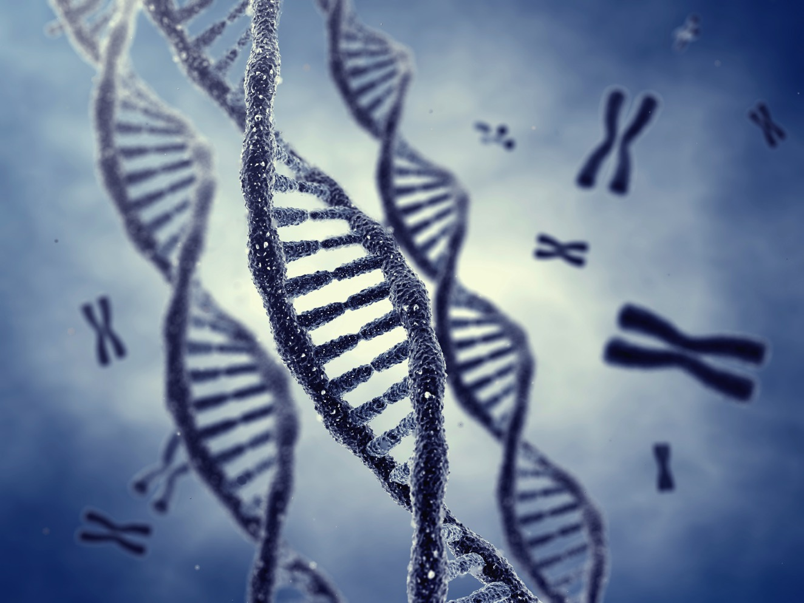

Sociogenomics and the Dynamic Genome:
A New Perspective on Nature and Nurture
Gene E. Robinson
Director,
Carl R. Woese Institute for Genomic Biology
Center for the Economics of Human Development
University of Chicago
May 11, 2018

Slide 2
Foundations of Sociogenomics
Social behavior is influenced by genes and shaped by evolution (Wilson 1971, Sociobiology)
Gene function is conserved between vertebrates and invertebrates (Carroll et al. 2001, From DNA to Diversity: Molecular Genetics and the Evolution of Animal Design)

Slide 3
Principles of Sociogenomics
1) Brain gene activity closely linked with behavior, across time scales: from physiological to evolutionary
2) Environmentally induced changes in gene activity cause changes in behavior
3) Relationship between genes and behavior is highly conserved, from animals to humans
Dynamic Genome: DNA is not destiny
Malleability of human traits: Policy implications

Slide 4

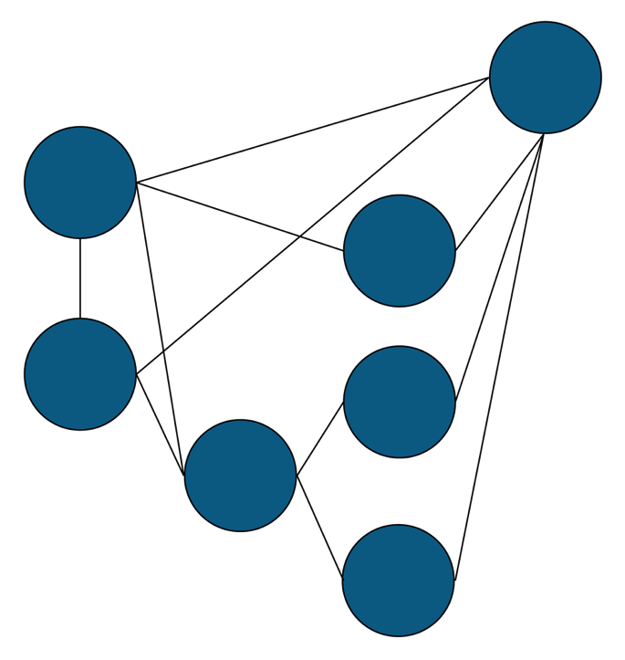
Poised for New Understanding of Human Nature
A Revised Sociogenomic Model of Personality Traits, B.W. Roberts, J. Personality, 2017
Social regulation of gene expression in human leukocytes , S.W. Cole…J.T. Cacioppo, Genome Biology, 2007
Behavioural genetics in criminal court, Scurich and Appelbaum Nature Human Behaviour, 2017)
Behavioral epigenetics: The last nail in the coffin of genetic determinism. D.F. Bjorklund Human Development, 2018)
Traits
Environment
Fluctuating
States
DNA
Elastic
Systems
Epigenetic
Systems
Pliable Systems

Slide 5
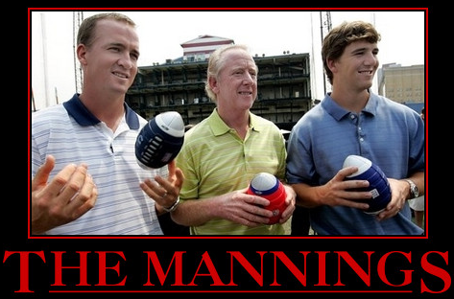
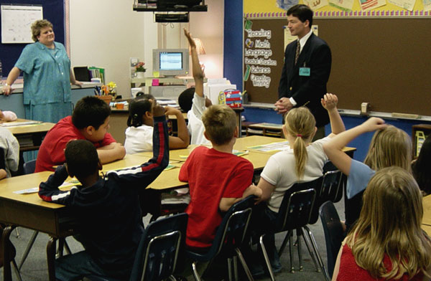
Genes!
Football Dynasty
Genes?

Slide 6
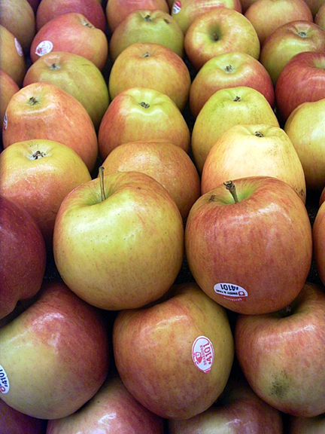
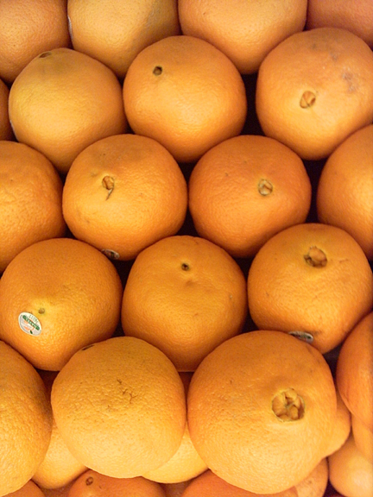
Nature and Nurture
Genes and Environment

Slide 7
Nature and Nurture
Genes and Environment
X

Slide 8
Nature and Nurture
Genes and Environment
Environment
Genome
DNA
Transcriptome
RNA
Behavior
Protein
→
→
(Robinson Science, 2004)
(Robinson et al. Science, 2008)

Slide 9
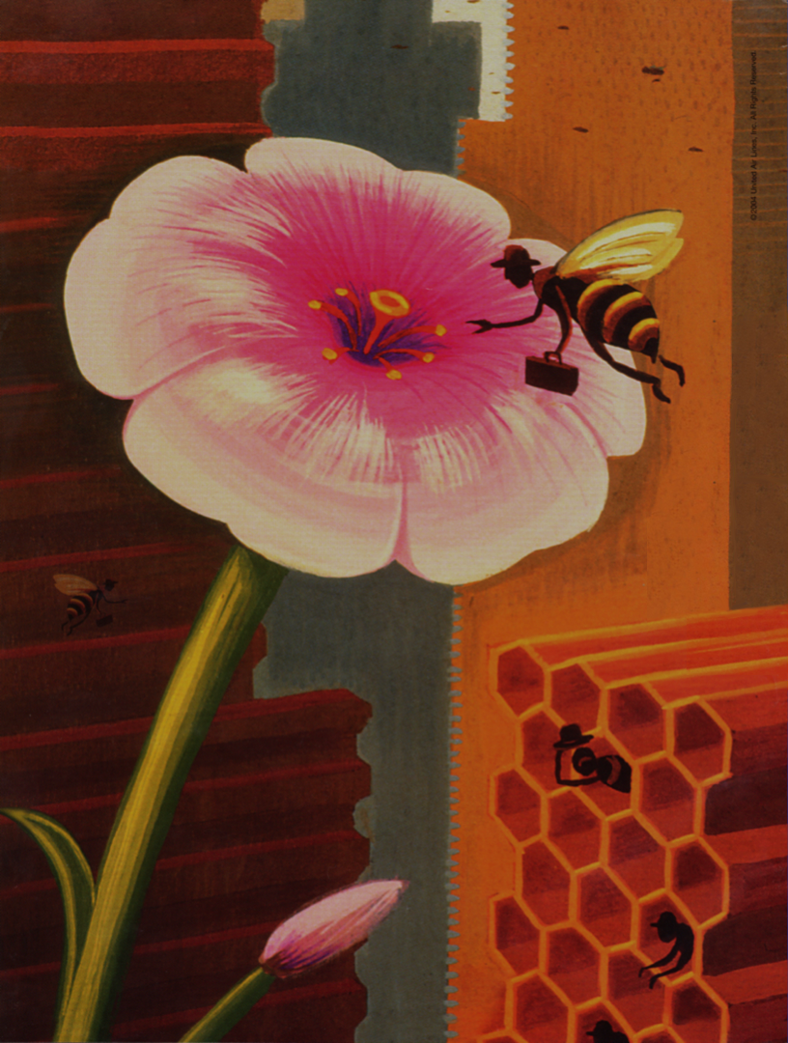
Model System
Division of labor in honey bee colonies
Extreme Behavioral States
Nurses, Builders, Foragers, Scouts, Guards, Soldiers, Scouts, Undertakers and more.
New York Times

Slide 10
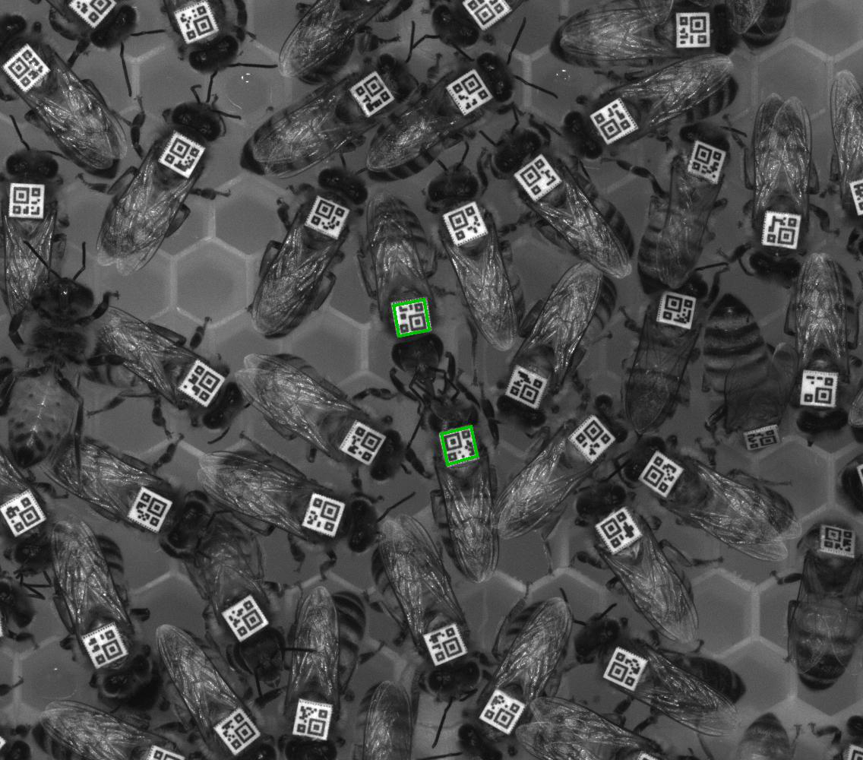
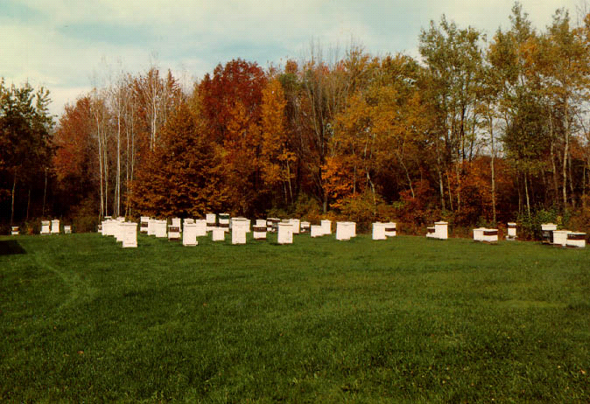
Model System
Normal behavior easily observed & manipulated
Social environment precisely controlled
Notes:
10

Slide 11

Social Engineering on a Grand Scale
Cross Fostering
Notes:
11

Slide 12
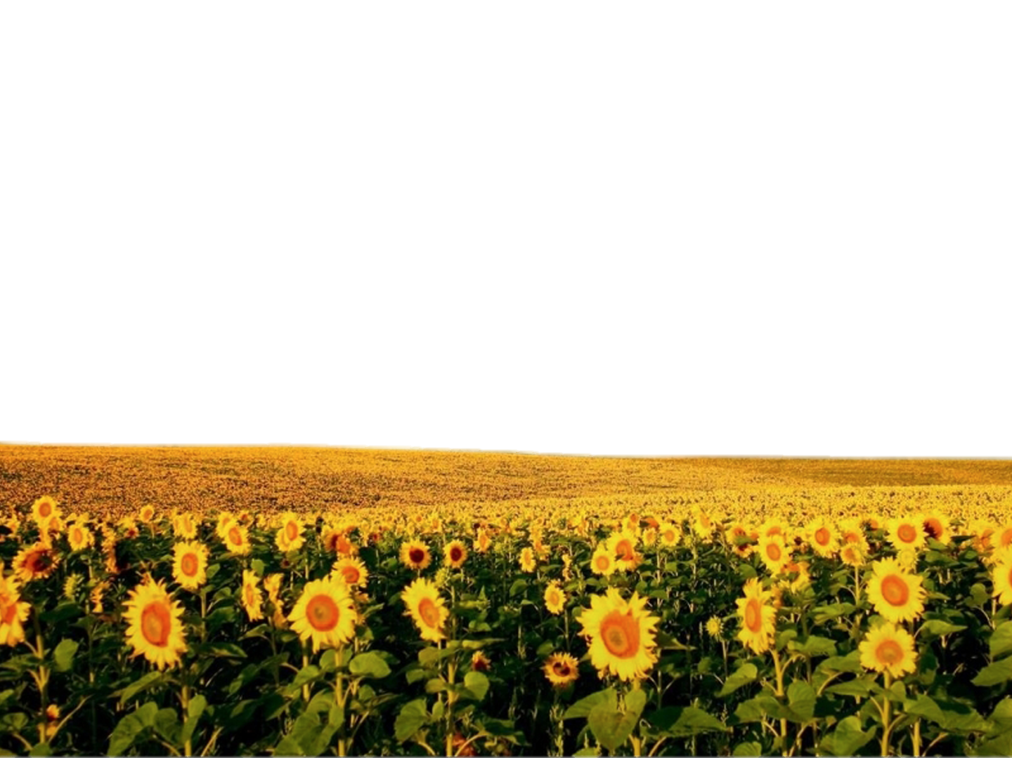
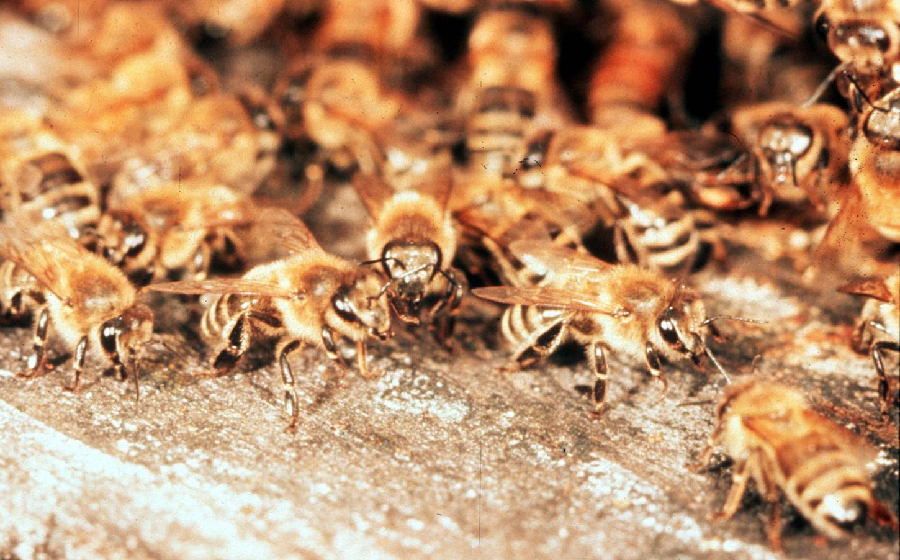
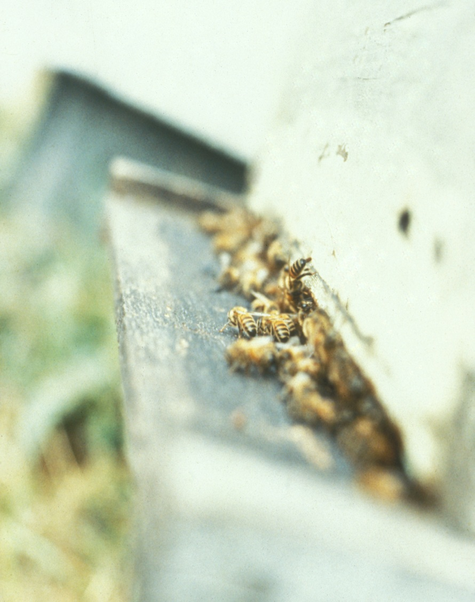
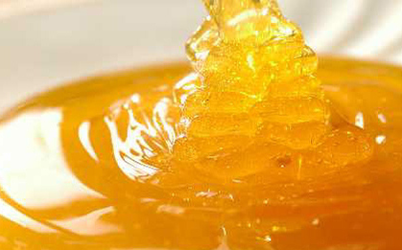
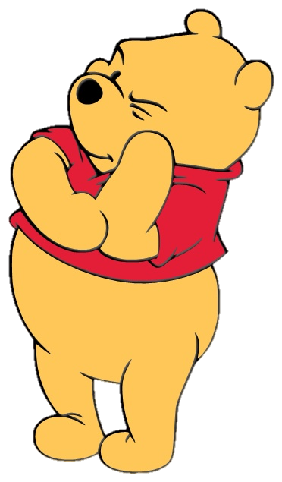
Model System: Hive Defense
Aggression
Ecological roots
Hereditary and social influences
Notes:
12

Slide 13
Model System: Social Foraging
Scouts and Recruits
Scouts seek food independently, communicate with language
Scouts abandon profitable food source (to keep on scouting)
Scouting has heritable and environmental influences
New York Times

Slide 14
Principles of Sociogenomics
1) Brain gene activity closely linked with behavior, across time scales: from physiological to evolutionary
2) Environmentally induced changes in gene activity cause changes in behavior
3) Relationship between genes and behavior is highly conserved, from animals to humans

Slide 15
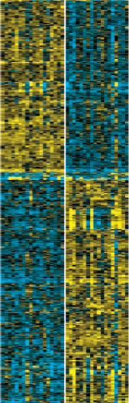
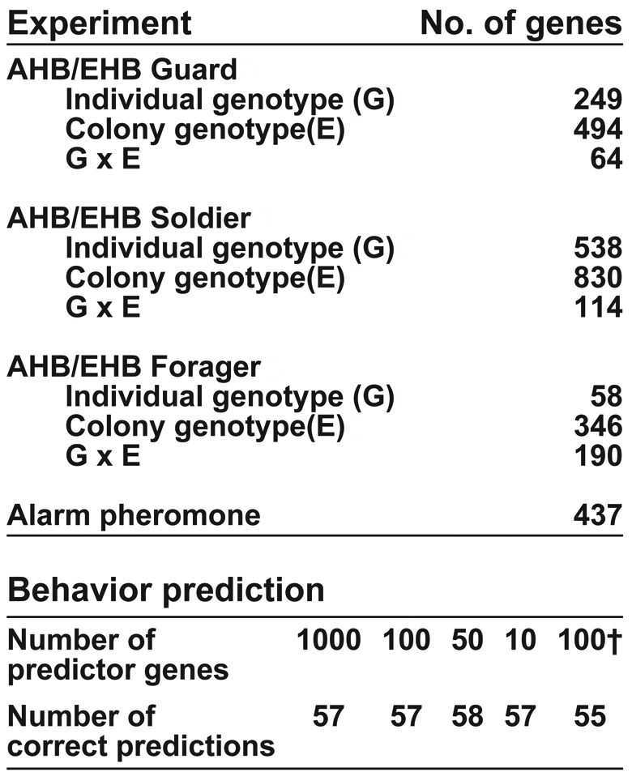
Aggression-Related Brain Gene Activity as a Function of Heredity and the Environment
(Ben-Shahar et al. Science, 2002)
(Whitfield et al. Science, 2003)
(Alaux et al. PNAS, 2009)
Notes:
15

Slide 16
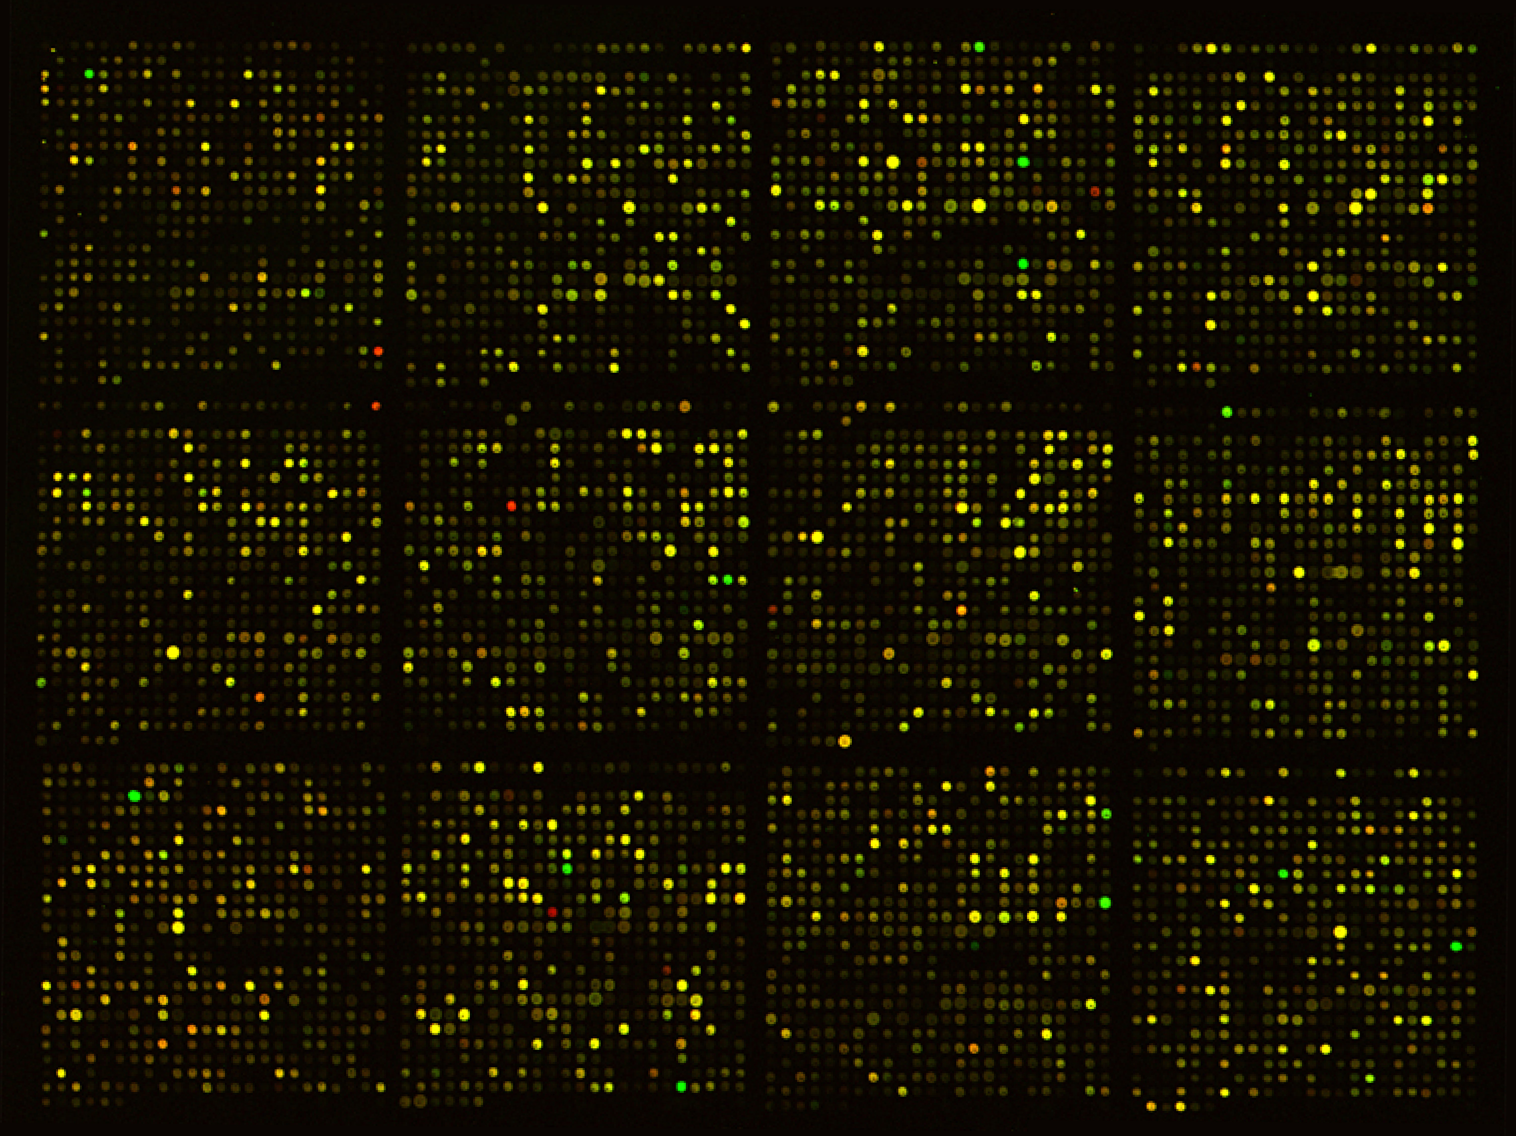
Alarm Pheromone Causes Hundreds of Differences in Brain Gene Activity
Notes:
16

Slide 17
Cross-fostering:
25% of the differences in brain gene activity due to social environment
Notes:
17

Slide 18
Overlap of AHB/EHB DEGS and Alarm Pheromone DEGs
Notes:
18

Slide 19
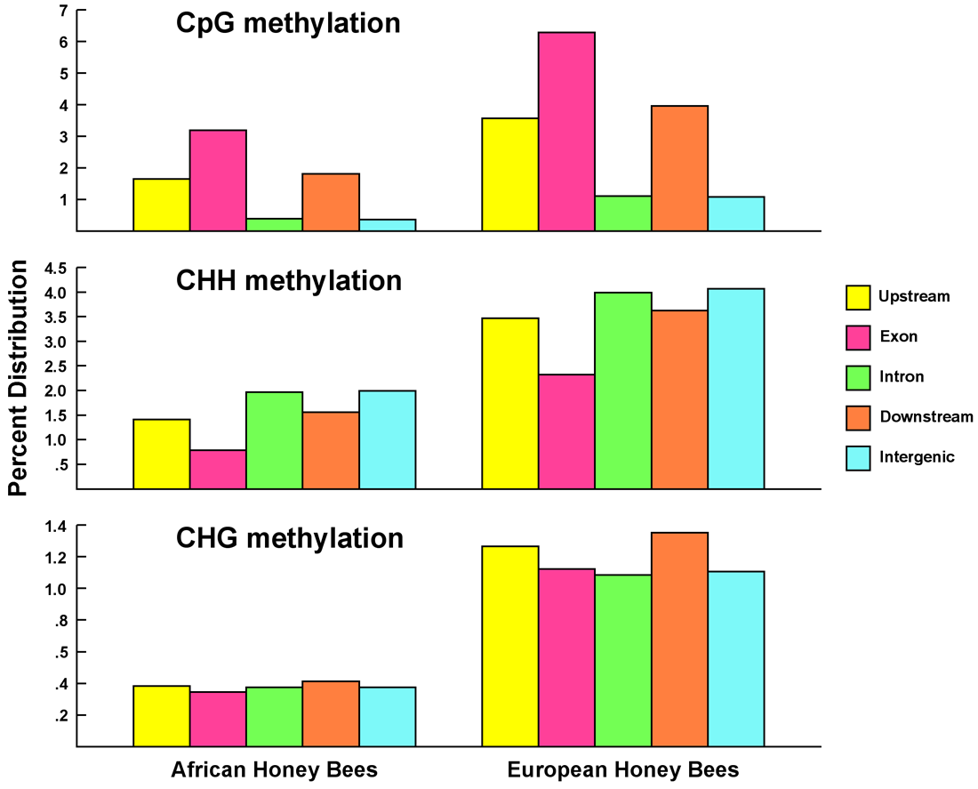
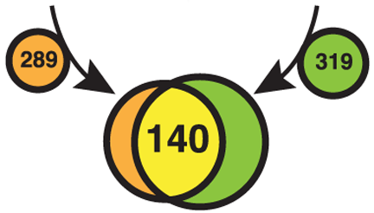
Aggression-Related Epigenetics
Overlap of DEGs and DMRs
AHB EHB
H = C, A, T
(Wang et al. Science, 2006)
(Cingolani et al. BMC Genomics, 2013)
(Herb et al. BMC Genomics, 2018)
Notes:
19

Slide 20
Principles of Sociogenomics
1) Brain gene activity is closely linked with behavior, across the time scales: from physiological to evolutionary
2) Environmentally induced changes in gene activity cause changes in behavior
3) Relationship between genes and behavior is highly conserved, from animals to humans

Slide 21
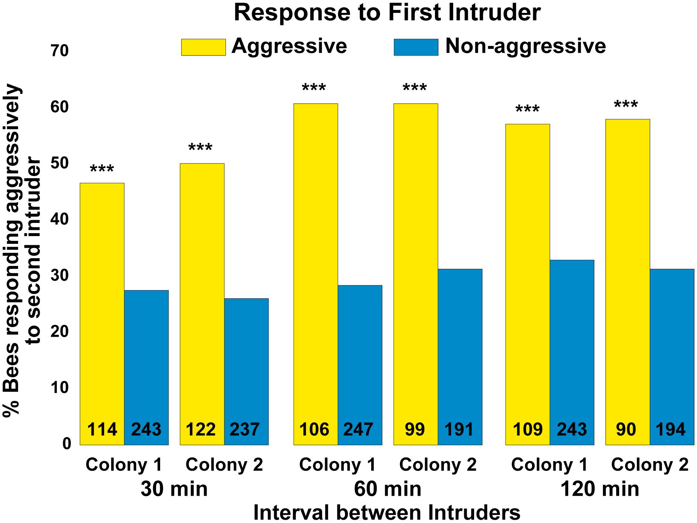
Effects on Future Behavior
6
5
b
bc
bc
4
ac
3
a
Colony responsiveness
2
1
0
0
1
2
3
4
5
6
Pheromone exposure (30 minute intervals)
(Shpigler et al. Genes, Brain and Behavior, 2017)
(Alaux & Robinson J. Chem Ecol., 2007)
Notes:
21

Slide 22

Aggression-Related Shift in Brain Metabolism
oxidative phosphorylation
glycolysis
(Alaux et al. PNAS 2009, Chandrasekaran & Rittschof et al. GBB, 2015 )
Notes:
22

Slide 23
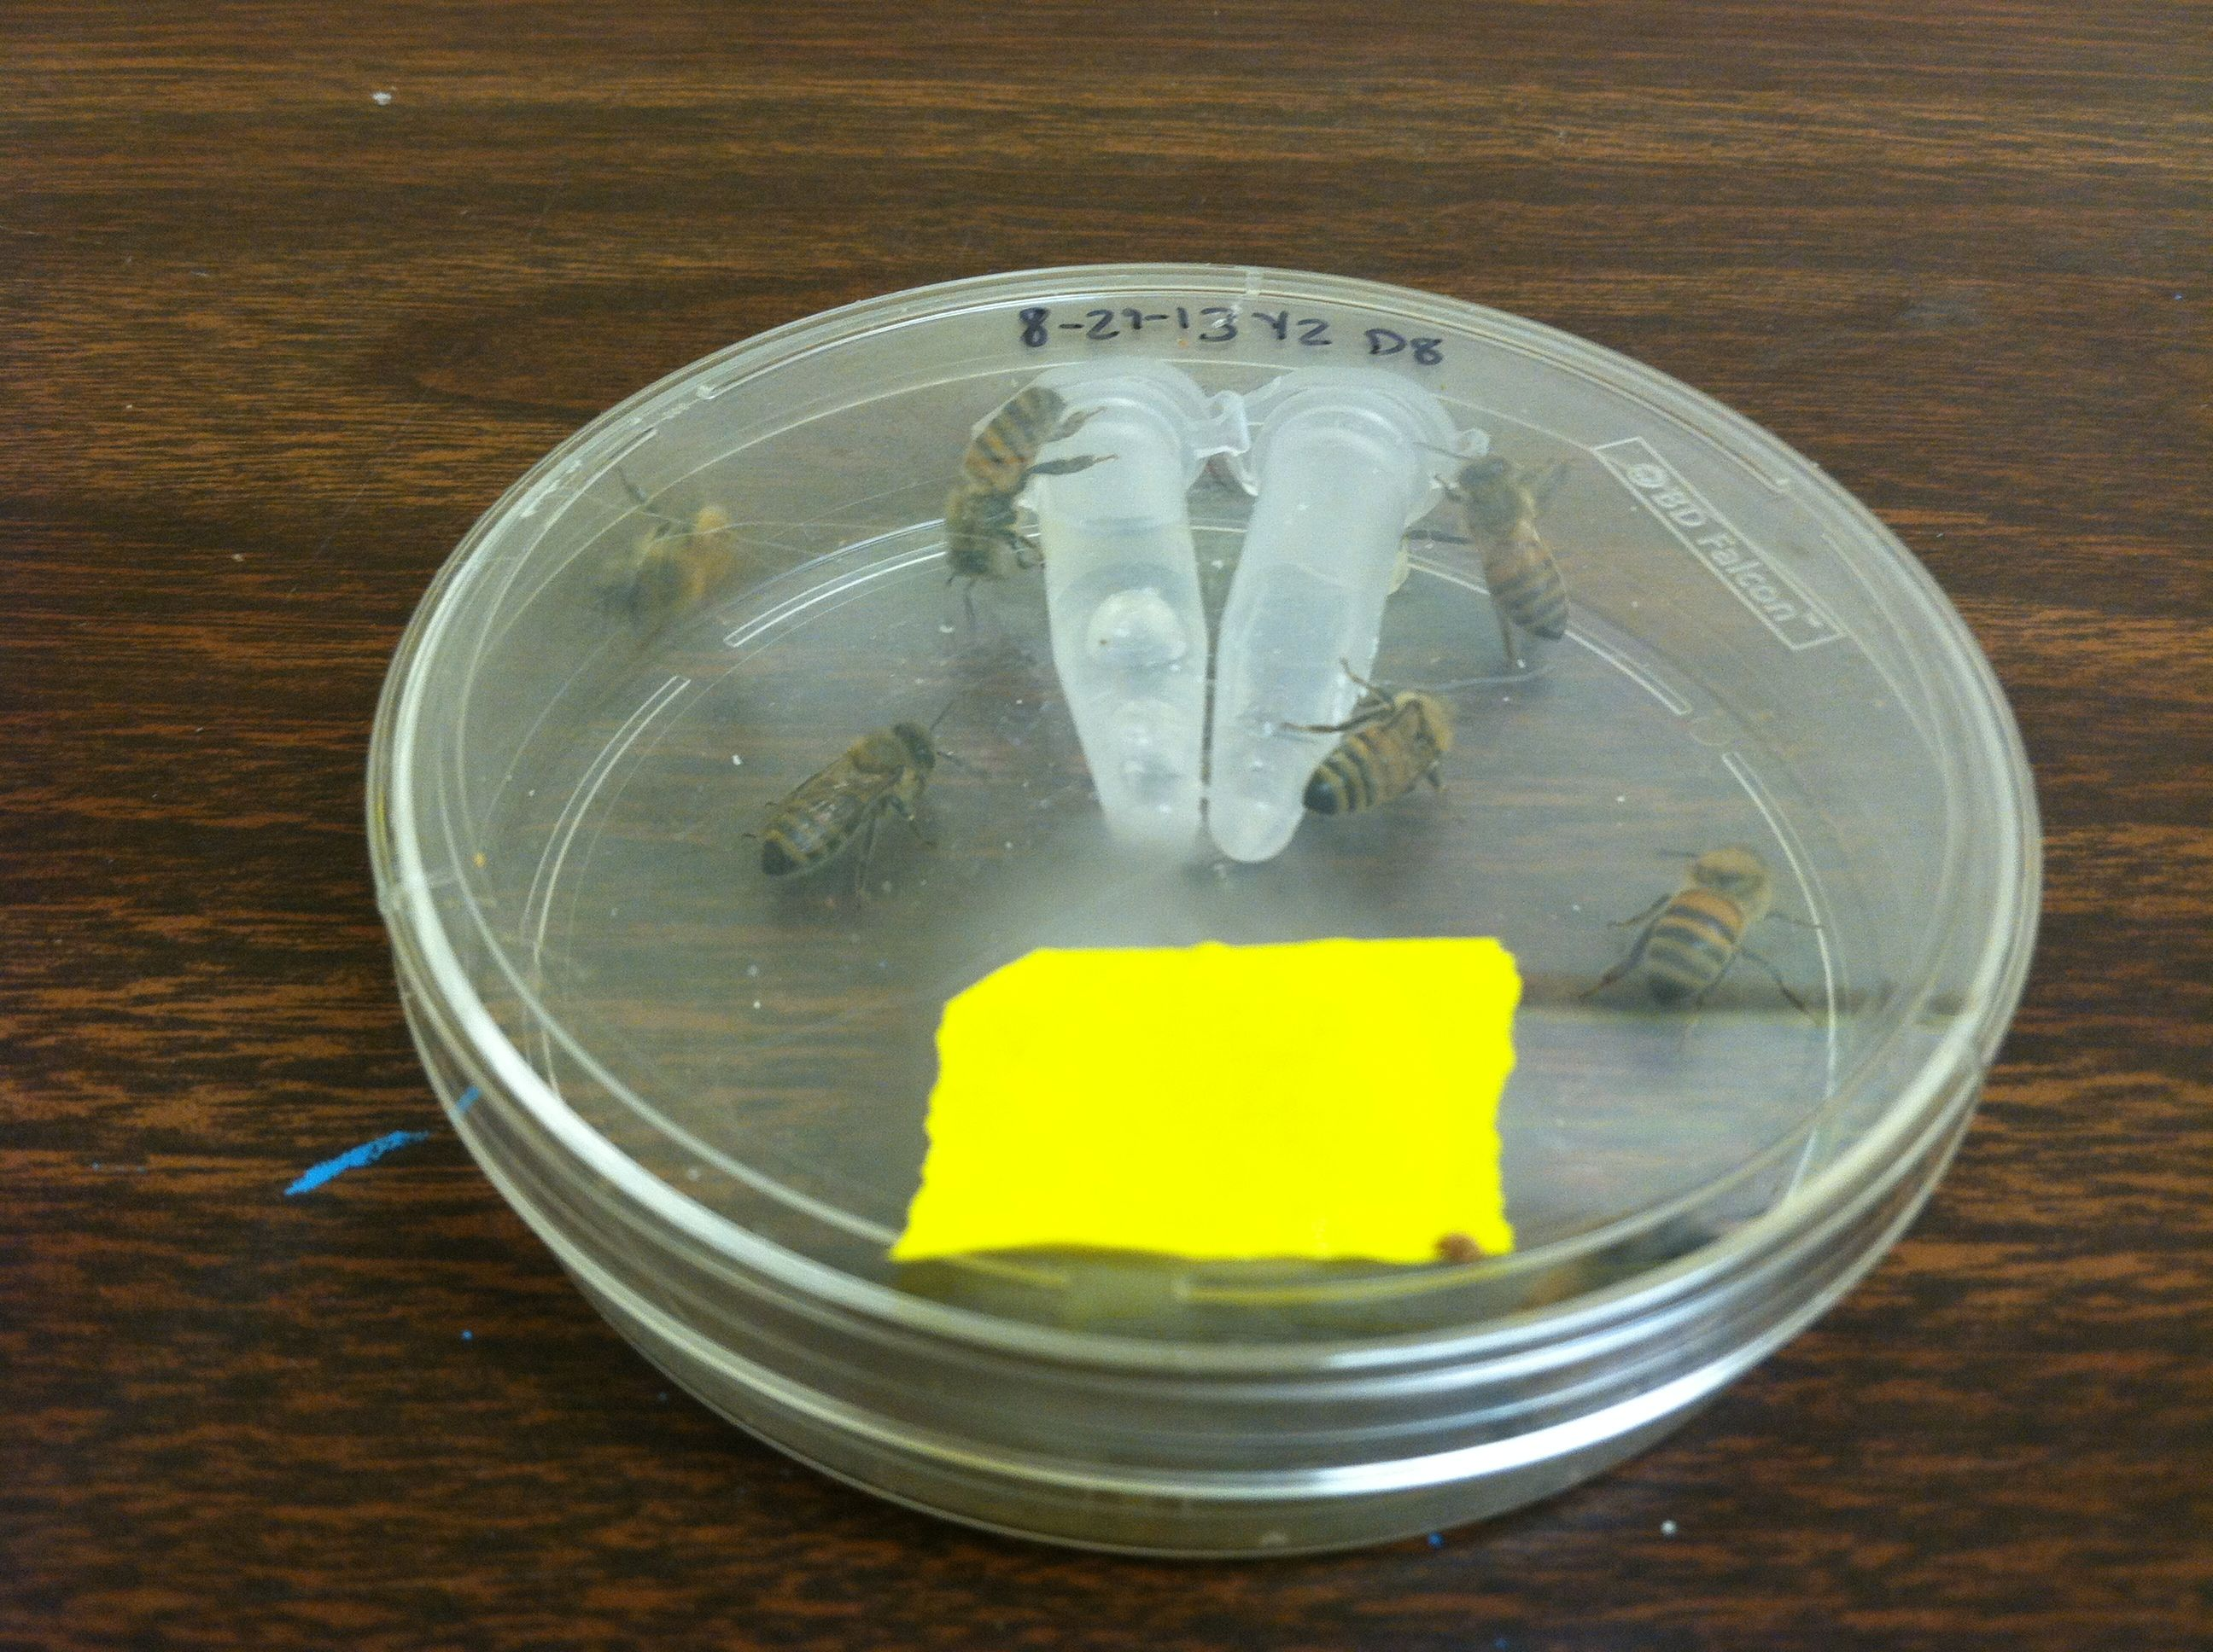
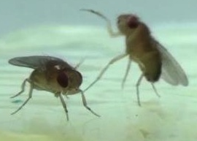
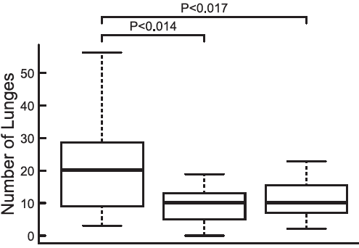
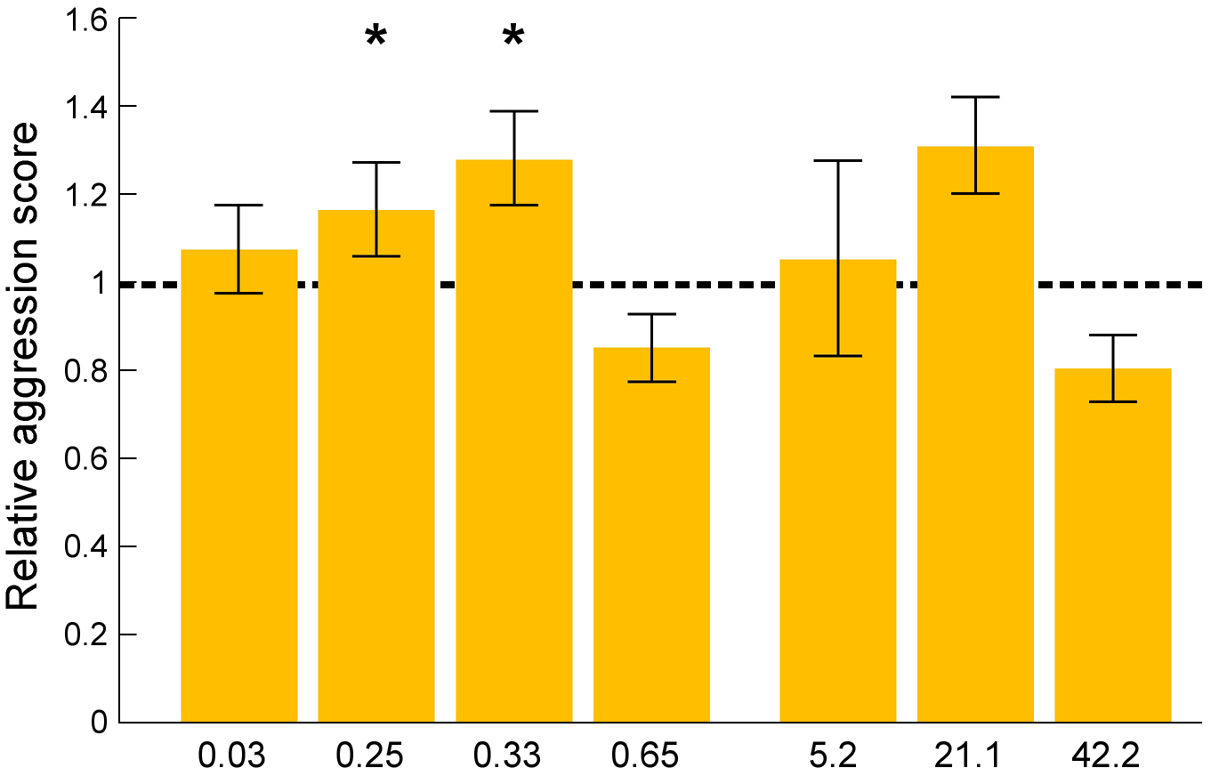
Environment→Genome→Behavior
Honey Bees
Fruit Flies
Fenpyroximate
(complex 1 inhibitor)
Tetradifon
(complex 5 inhibitor)
*
*
*
elavl
ND20-like
RNAi
elavl
ND20-like
RNAi
Dosage
(ug/bee)
(Li-Byarlay & Rittschof et al. PNAS, 2014)

Slide 24
Principles of Sociogenomics
1) Brain gene activity is closely linked with behavior, across the time scales: from physiological to evolutionary
2) Environmentally induced changes in gene activity cause changes in behavior
3) Relationship between genes and behavior is highly conserved, from animals to humans

Slide 25

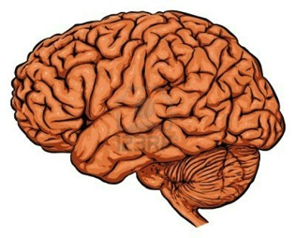
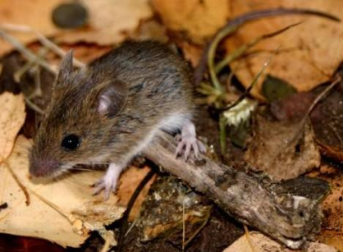
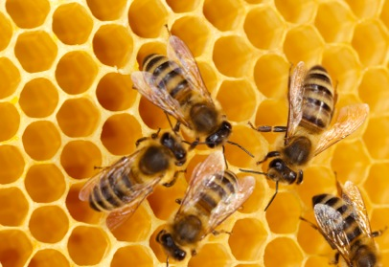
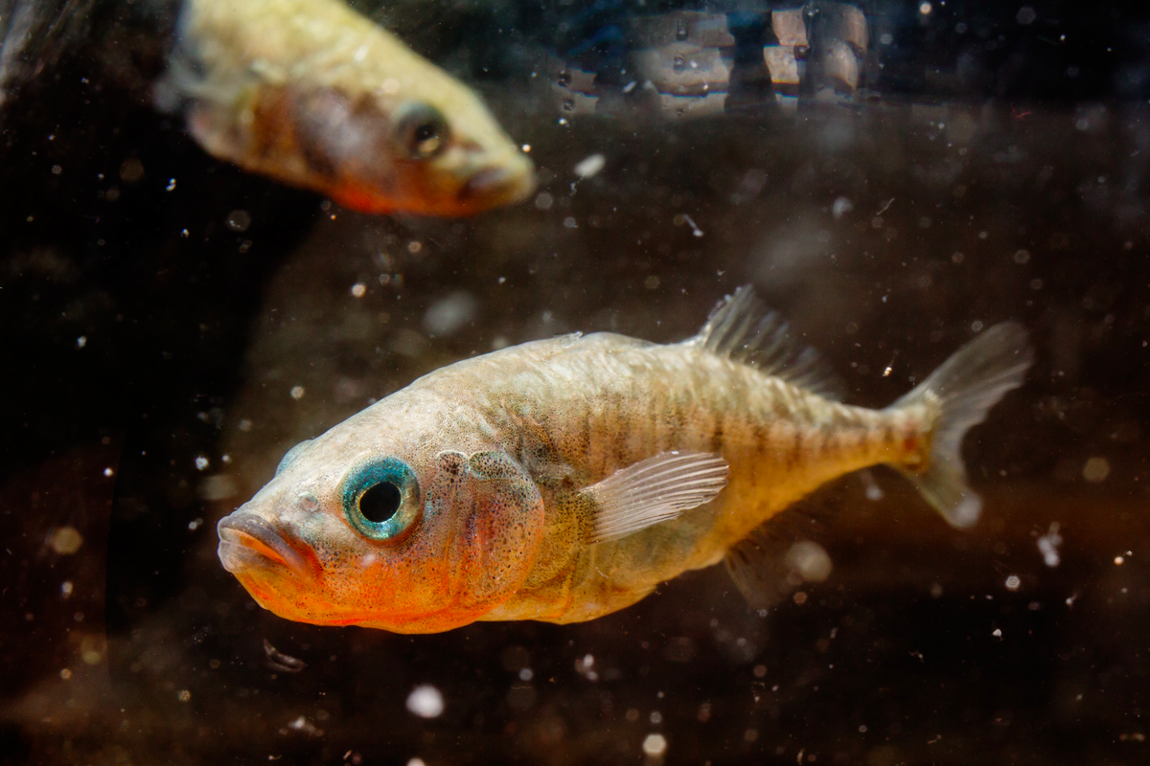
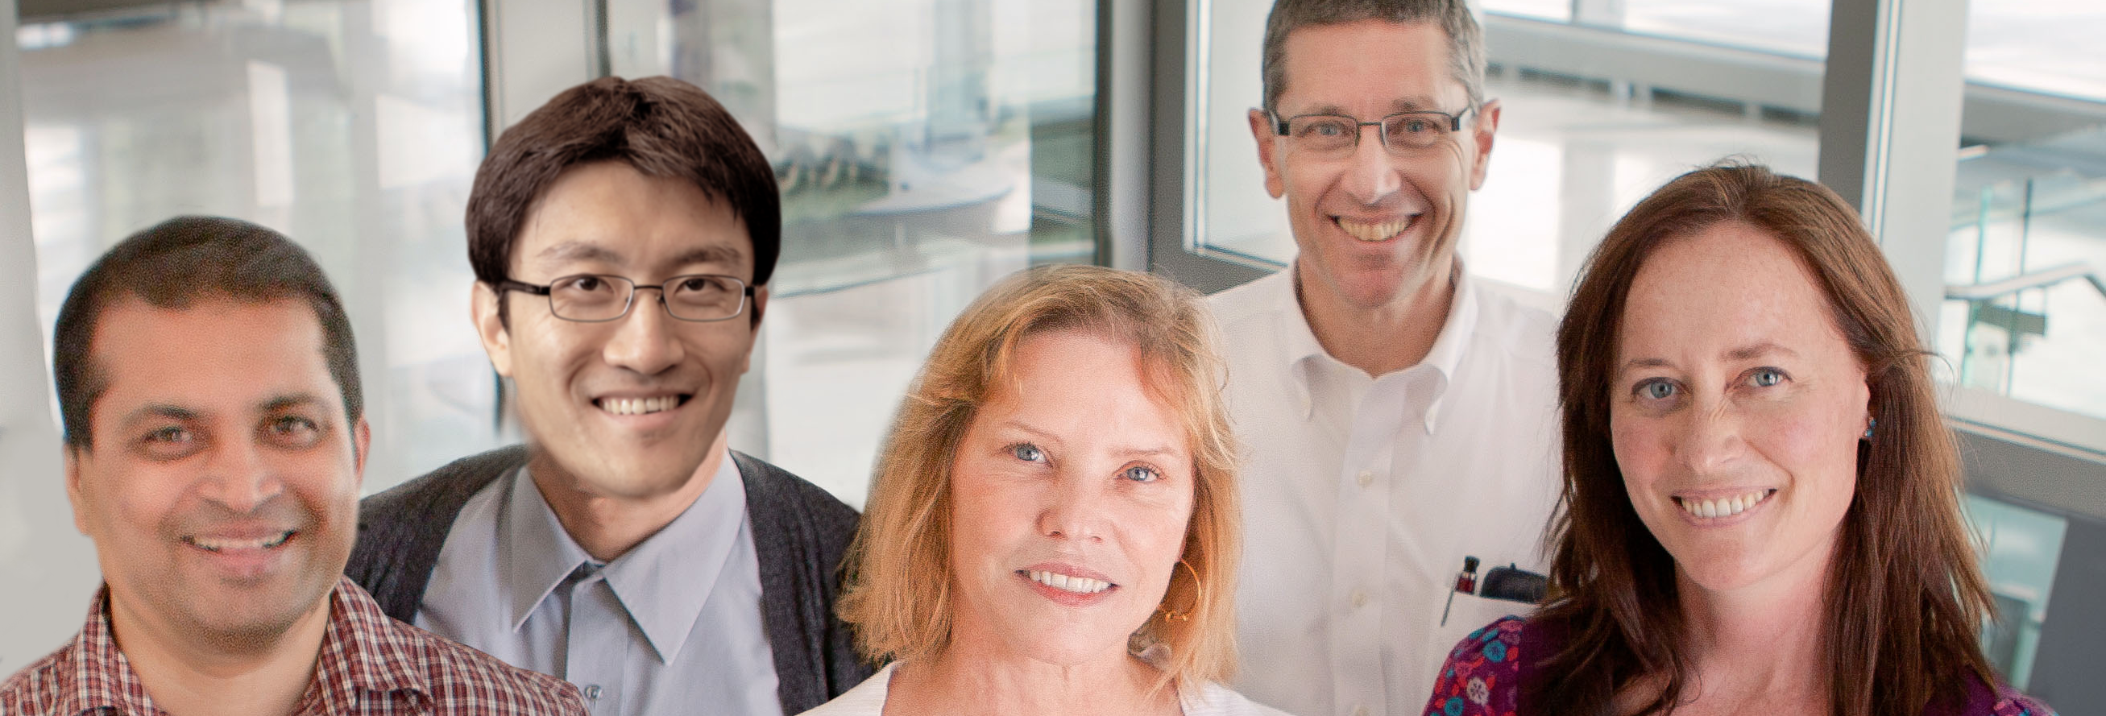
Do Brain Responses to Social Information Involve Evolutionarily Conserved Mechanisms?
Social cues
Behavior
Gene Networks in Neural and Developmental Plasticity IGB Thematic Research Group:
S. Sinha, D. Zhao, L. Stubbs,
G. Robinson. A. Bell

Slide 26
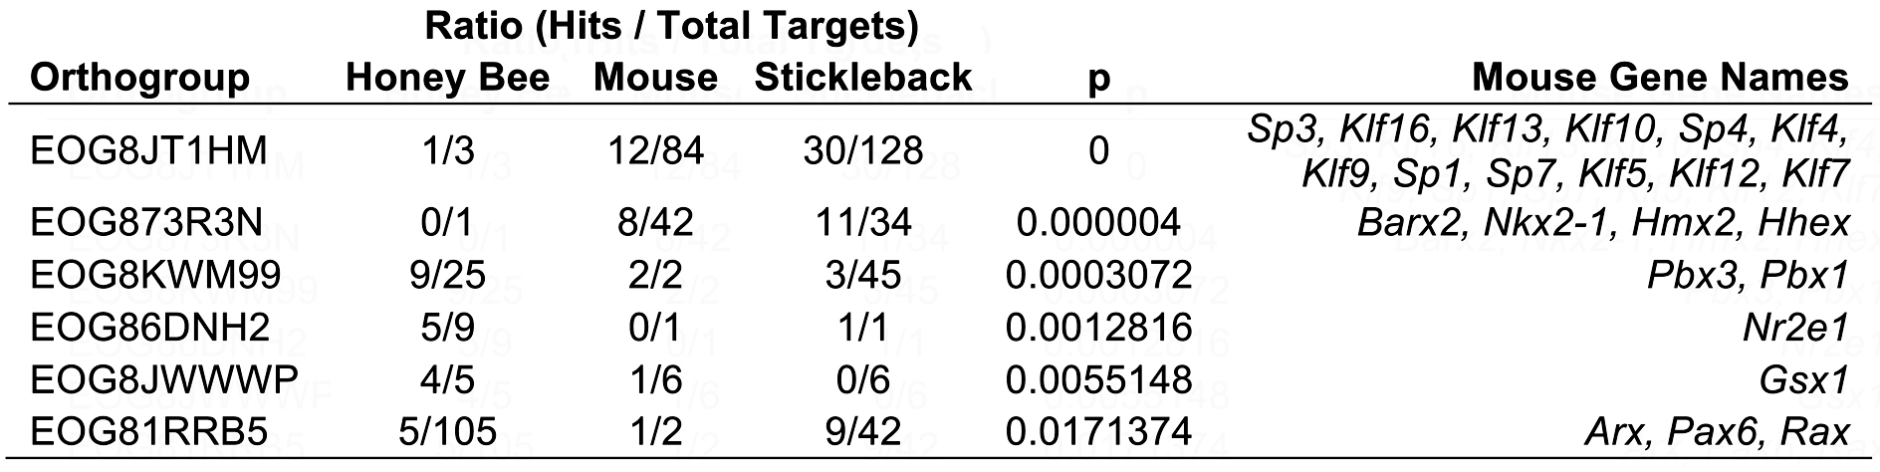
Conserved Transcription Factors Implicated as Regulators of Response
to Social Challenge
(Saul…Sinha et al. submitted )
Notes:
Make them all this size

Slide 27
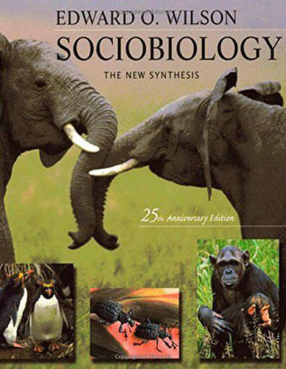
Deeper Conservation?
“It is the task of comparative sociobiology to trace these and other human qualities as closely as possible back through time.”
E.O. Wilson, 1975
This was beyond science’s ability in 1975.

Slide 28
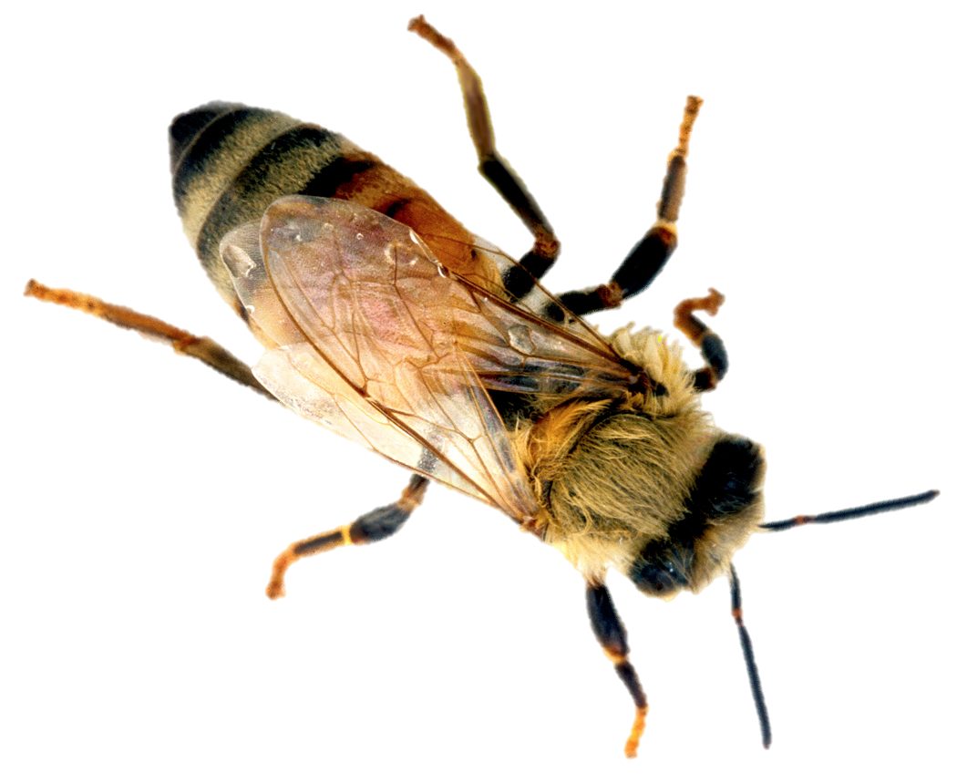
SocialLY UNResponsivE BEES
Opportunity
Queen
Larva
Challenge
Intruder
UNRESPONSIVE
INDIVIDUALS

Slide 29
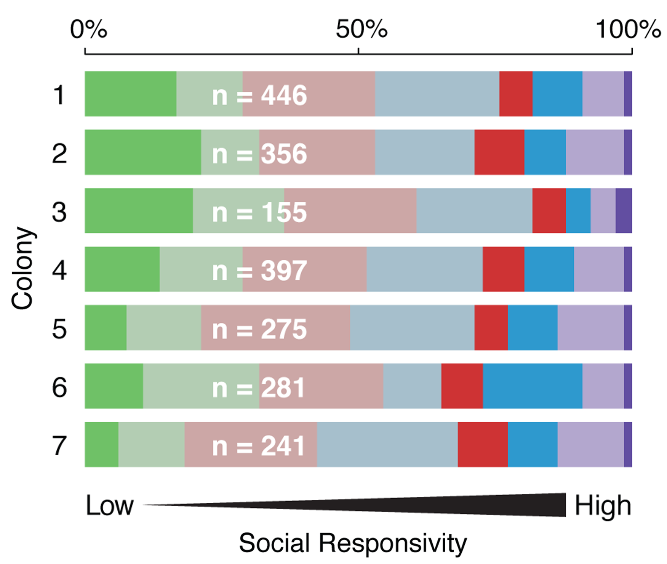
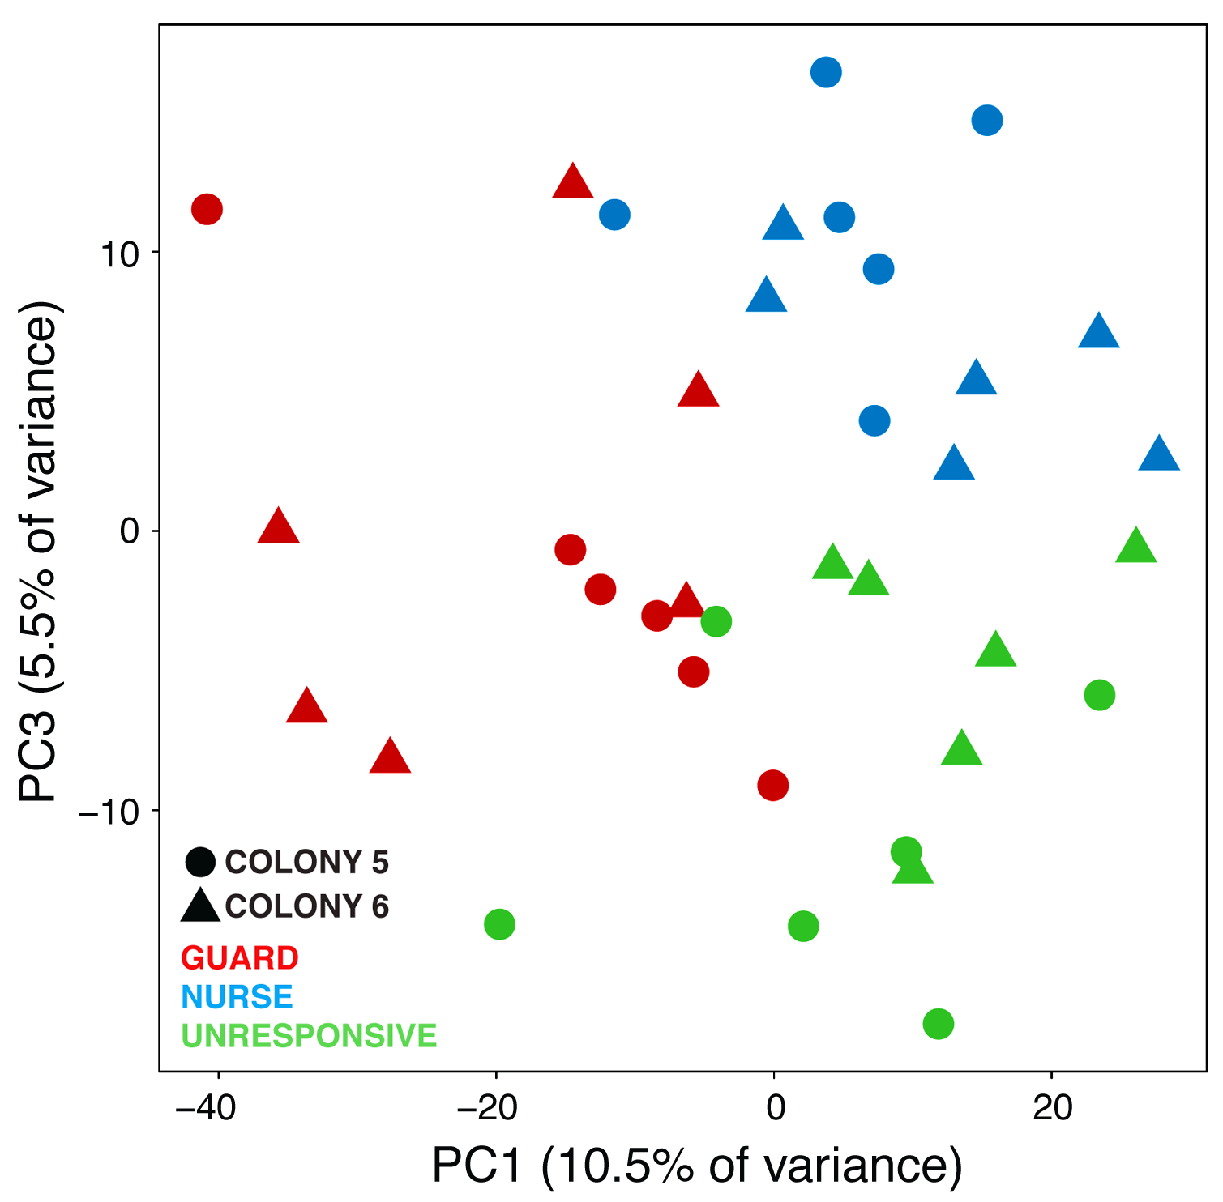
Individual Differences in Social Responsiveness: Autism Connections?
Behavior Gene Expression
(Shpigler, Saul, Zhao & Robinson PNAS, 2017)

Slide 30
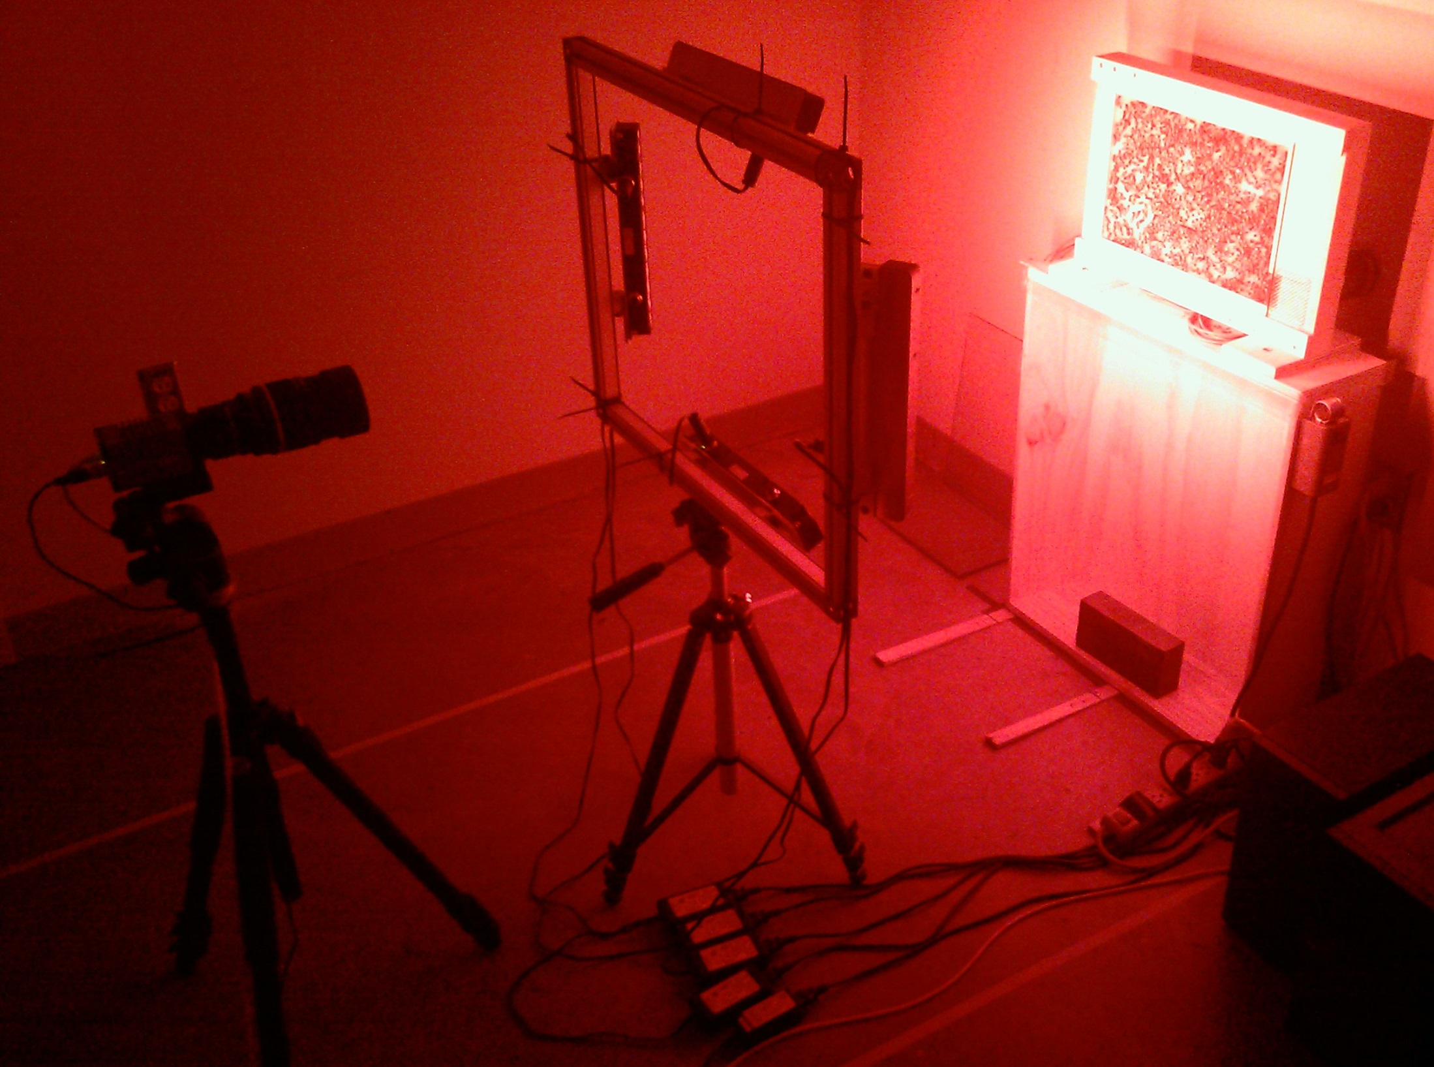
Automated Behavioral
Monitoring
Camera
Infrared
lights
Computer
Notes:
Over one million social interactions over the course of the entire experiment!

Slide 31
Observation
hive
Camera
Infrared
lights
Computer
Notes:
Over one million social interactions over the course of the entire experiment!

Slide 32
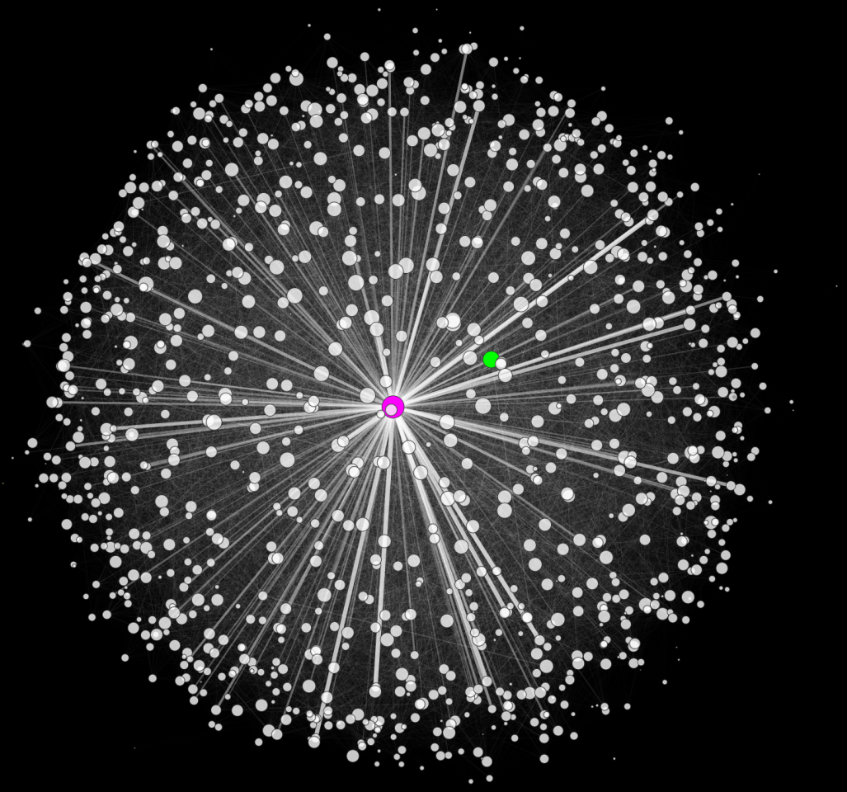
Party Bee:
553 interaction partners
922 interactions
Lonely Bee:
23 interaction partners
24 interactions
Queen Bee:
745 interaction partners
4368 interactions
(Gernat et al. PNAS, 2018)

Slide 33
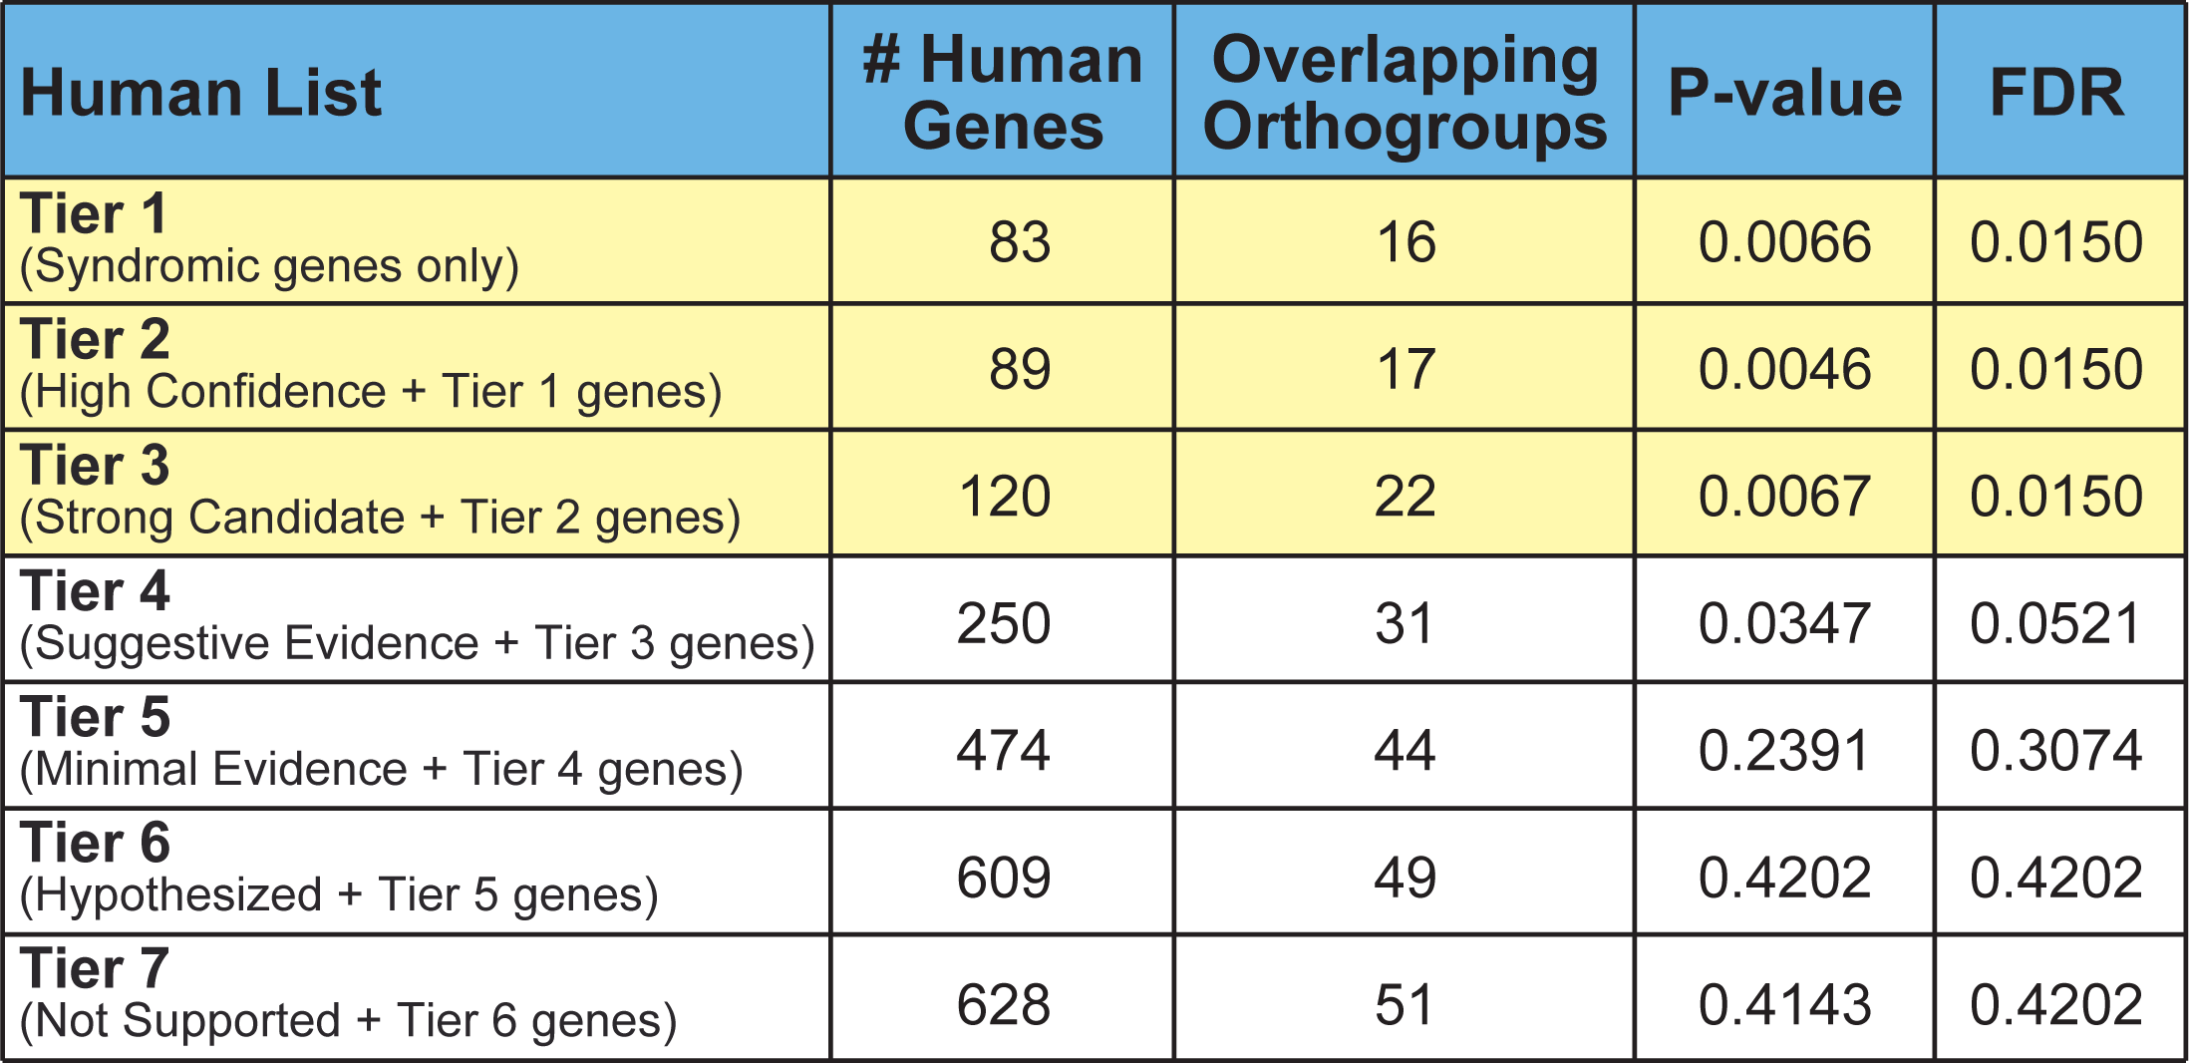
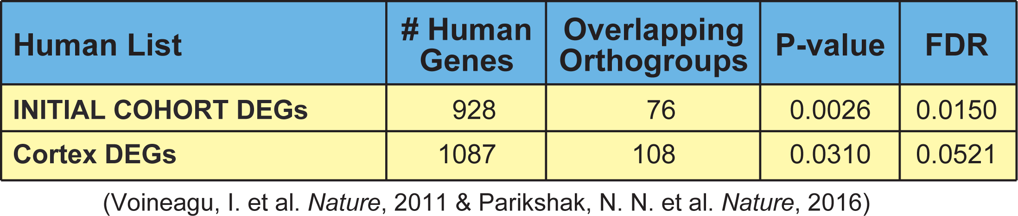
Evolutionary Conservation of Autism-Related Genes in Honey Bees
SFARI GSM Database
Post-Mortem Brain Cell Expression
Overlaps include: voltage- and ion-gated channels (GABA receptor), heat shock proteins
(Shpigler, Saul, Zhao & Robinson PNAS, 2017)

Slide 34
Conservation of Autism-Related Genes
Controls
No significant overlaps between:
1) Bee gene set and mental illness gene sets
2) Autism gene sets and other bee behavioral gene sets
(Shpigler, Saul, Zhao & Robinson PNAS, 2017)

Slide 35
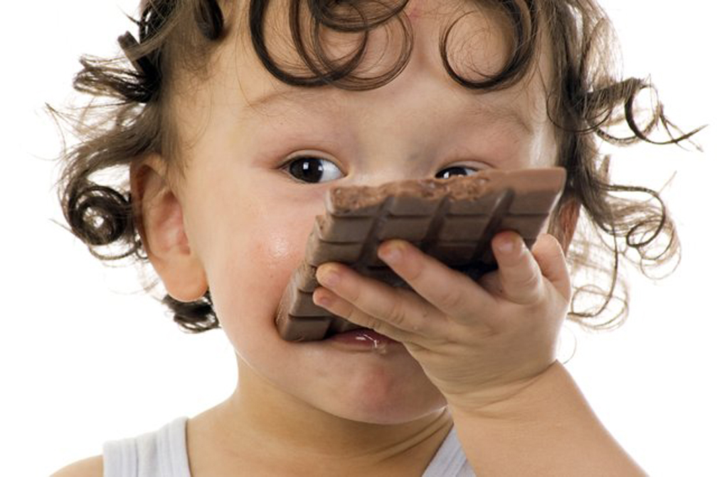
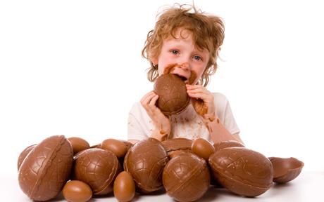
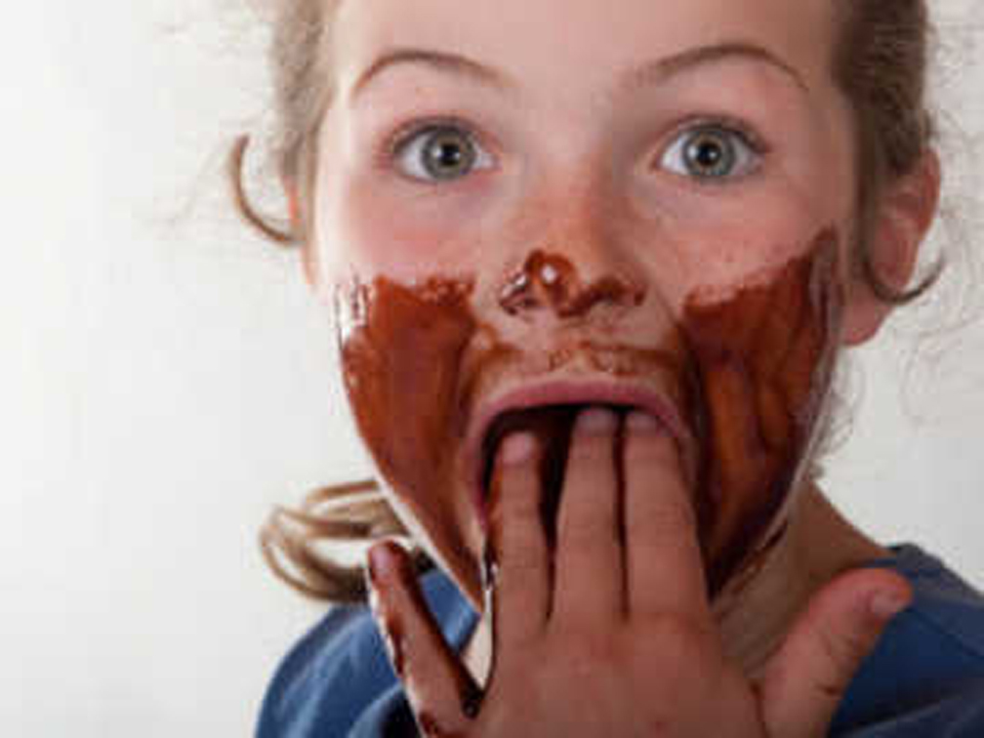
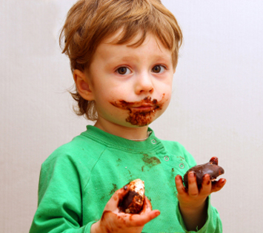
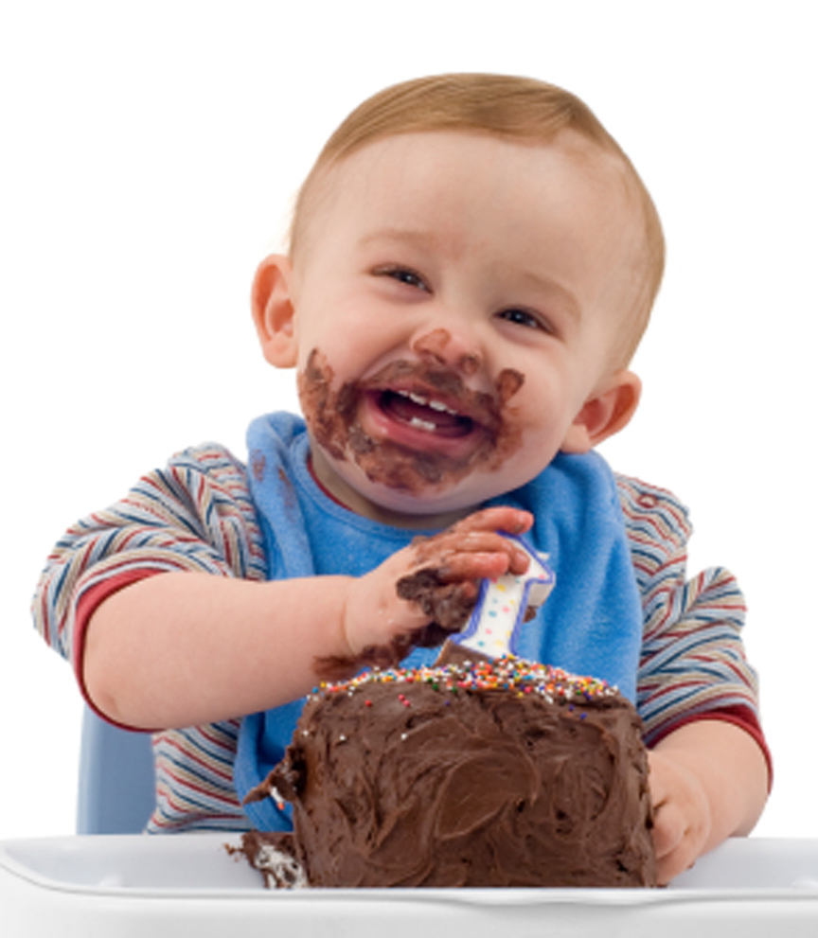
Addicted
to
Sweets!

Slide 36
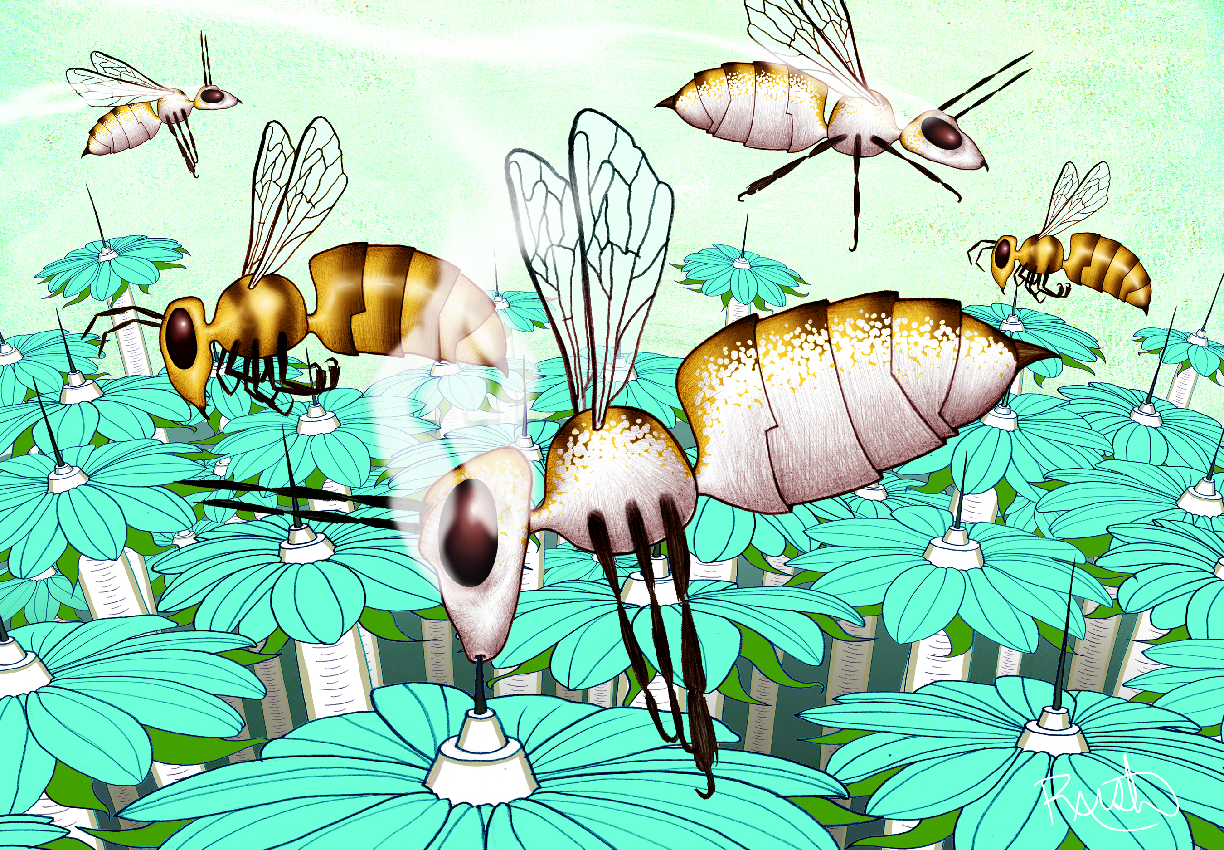
Addicted to Sweets?
Notes:
36

Slide 37
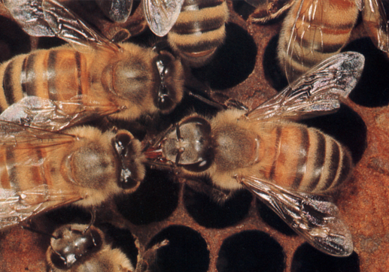
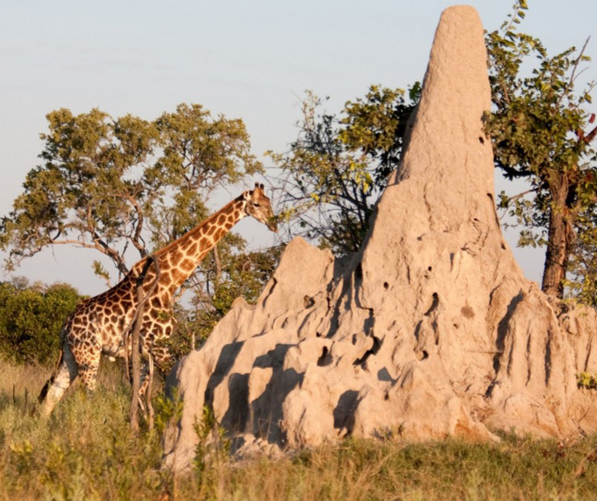
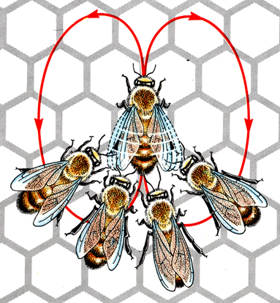
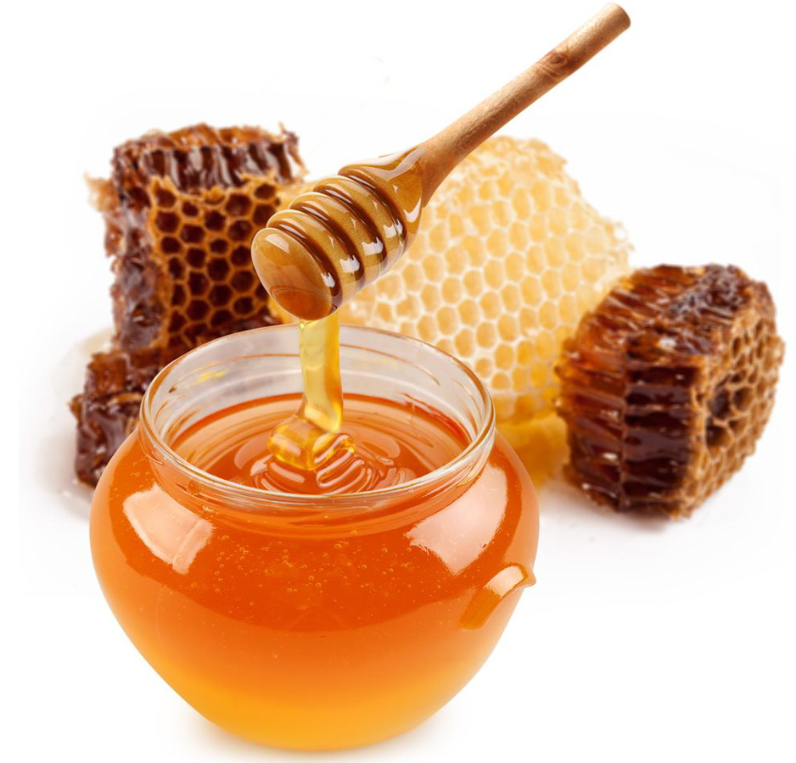
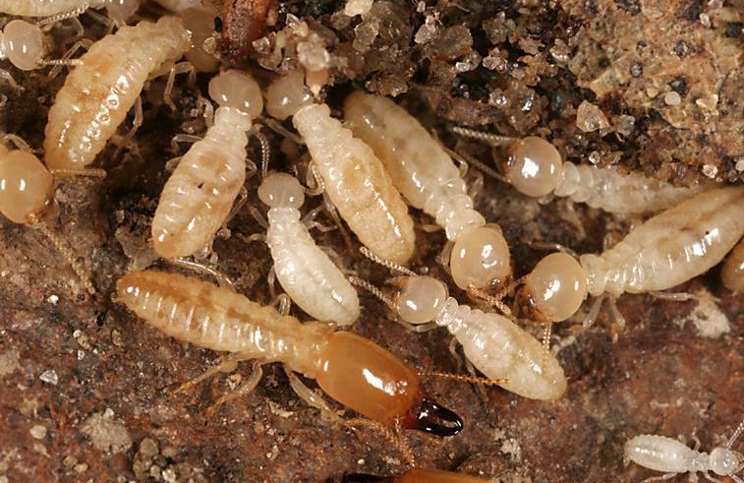
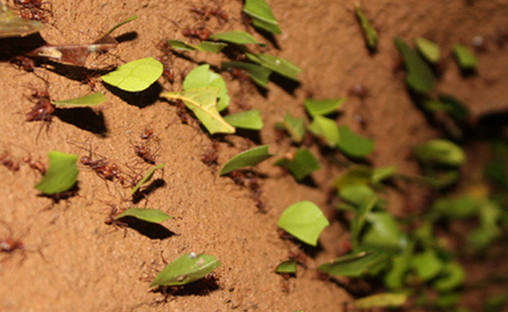



Addicted to Altruism?
Language
Manufacture
Construction
Honey Bees
Honey Bees
Termites
Long Now Foundation
Agriculture
Warfare
Leaf Cutter Ants
Honeypot Ants

Slide 38



Ancient Roles of Brain Reward Systems
Dance Language
Distance
Direction
Value

Slide 39
Ancient Roles of Brain Reward Systems
a
a
b
b
ab
0.4
N = 30-50
0.3
0.2
dance likelihood
0.1
none
DMF
2 ug OA
3 ug COC
3 ug COC + 2 ug MI
(Barron et al. PNAS, 2007; Barron et al. J Exp Biol, 2009)

Slide 40
Ancient Roles of Brain Reward Systems
a
a
b
b
ab
0.4
N = 30-50
0.3
OA blocker also
blocks cocaine
effect
0.2
dance likelihood
0.1
none
DMF
2 ug OA
3 ug COC
3 ug COC + 2 ug MI
(Barron et al. PNAS, 2007; Barron et al. J Exp Biol, 2009)

Slide 41
Conservation of Novelty-Seeking Genes
Expression Ratio (S/N)
Ratio of Expression Differences (S/N)
(Liang, Nguyen, Mattila, Rodriguez-Zas, Seeley & Robinson Science 2012)

Slide 42




Toolkits for Social Behavior
600 mya

Slide 43
Poised for New Understanding of Human Nature
Animal models reveal the real relationship between genes and behavior:
Soldier and Guard bees: Dynamic genome, across time scales, context-dependent effects (Avalos, Robinson and Hudson, unpubl.)
Scout bees: “addicted to altruism,” and with personality differences (Liang et al. Science, 2012)
Wasps and voles: co-opted parental care mechanisms for eusociality and romance, respectively (Donaldson & Young Science, 2008; Toth et al. Science, 2007)
DNA is not destiny
DNA is not “DNA!” --Early life experience changes genome in mice (Bedrosian et al. Science, 2018)
No GATTACA: abundance of higher order genetic interactions (Giaever et al. Nature, 2018)

Slide 44
Poised for New Understanding of Human Nature
A Revised Sociogenomic Model of Personality Traits, B.W. Roberts, J. Personality, 2017
Integrate state-trait models with evolutionary biological models to inform assessment and intervention science
Malleability of human traits? Policy implications
Social regulation of gene expression in human leukocytes , S.W. Cole…J.T. Cacioppo, Genome Biology, 2007
It’s all in your head: Expression associated with subjective loneliness
Bees too (Sen Sarma et al. Genes, Brain and Behavior, 2010)
Behavioural genetics in criminal court, Scurich and Appelbaum Nature Human Behaviour, 2017)
MAOA-L allele (GxE interactions)
Behavioral epigenetics: The last nail in the coffin of genetic determinism. D.F. Bjorklund Human Development, 2018)
Brain and behavior develop over time
Genes always expressed in context
Epigenetics embeds experience

Slide 45
Technical Challenges to Extending Sociogenomics to Humans
Need better ways to measure brain gene expression in humans.
Autopsy
Blood cells as biomarkers
Brain organoids?
Disembodied pig brains!
New imaging methods?

Slide 46

Some Current and Former Lab Members
C. Alaux
S. Ament
Barron
A. Brockmann
H. Li-Byarlay
T. Gernat
Hamilton
B. Jones
K. Kapheim
M. McNeill
C. Rittschof
M. Saul
H. Shpigler
I. Traniello
A. Cash Ahmed
C. Nye
A. Sankey
Collaborators
Bell
S. Chandrasekaran (Univ. Michigan)
R. Mendenhall
N. Price (Inst. Systems Biology)
B. Roberts
S. Rodriguez-Zas
S. Sinha
L. Stubbs
D. Zhai
10Bee Team
Keck Center for Functional
and Comparative Genomics (Illinois)
Honey Bee Genome Sequencing Consortium
HymenopteraBase (C. Elsik)
BGI
Simons Foundation, NIH, NSF, DARPA
Notes:
46

